Slide 1
RM-2 Alignment notes
Alberto H. Gay
5/15/2019
Confidential

Slide 2
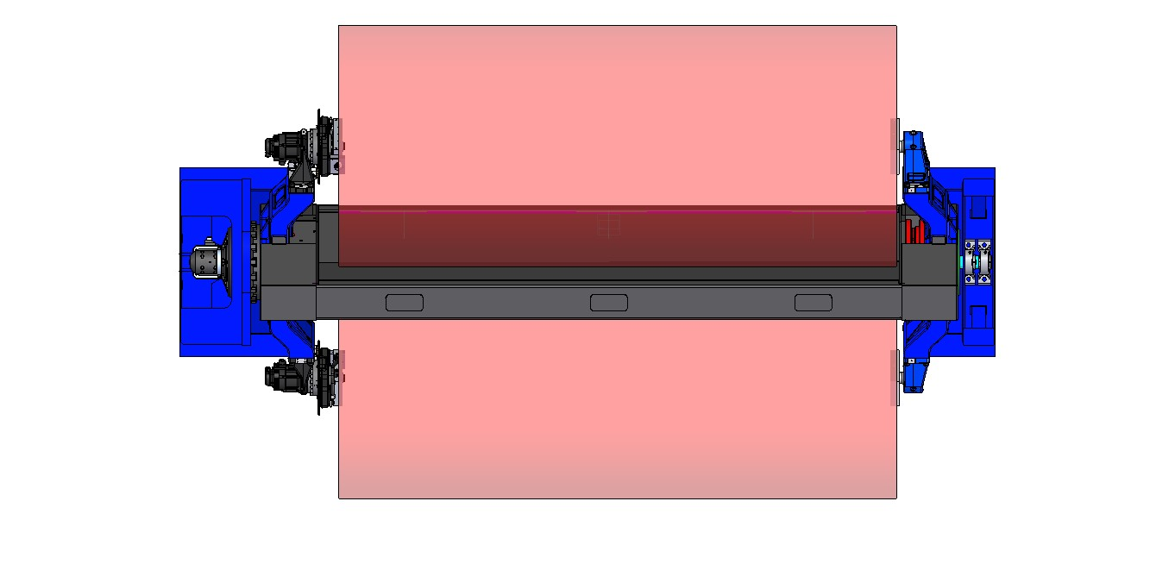
Spread Offset and Yaw
Spread
Offset
Yaw
Yaw
Confidential

Slide 3
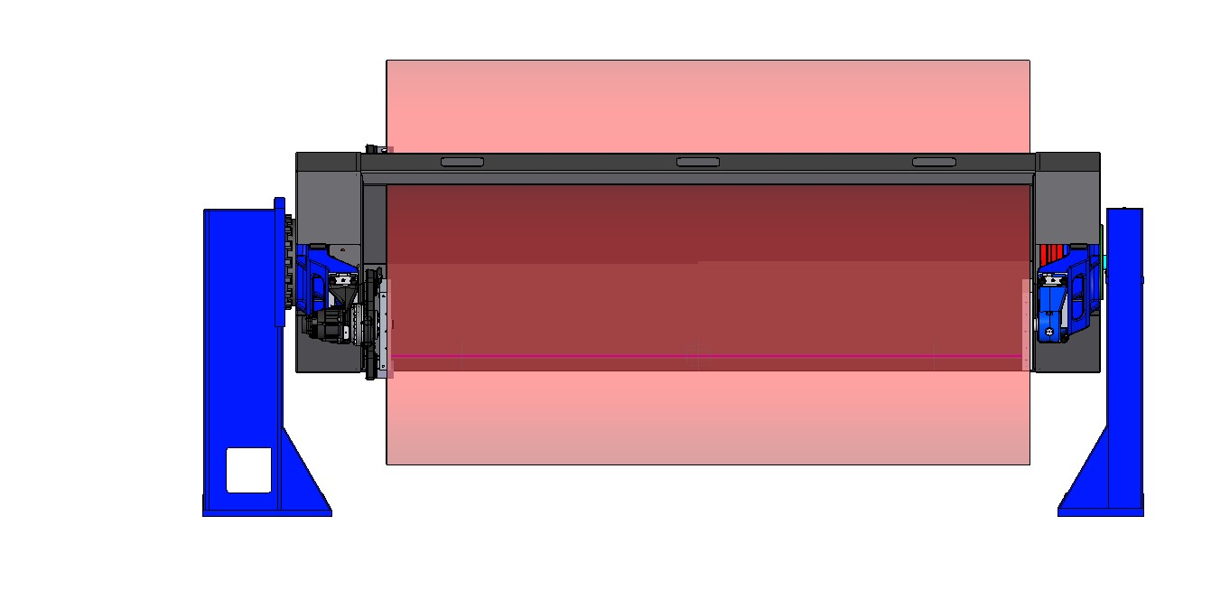
Elevation and Pitch
Pitch
Pitch
Elevation
Note: Headstock is hard mounted – target it 90 +/- 0.5 degrees
Confidential

Slide 4
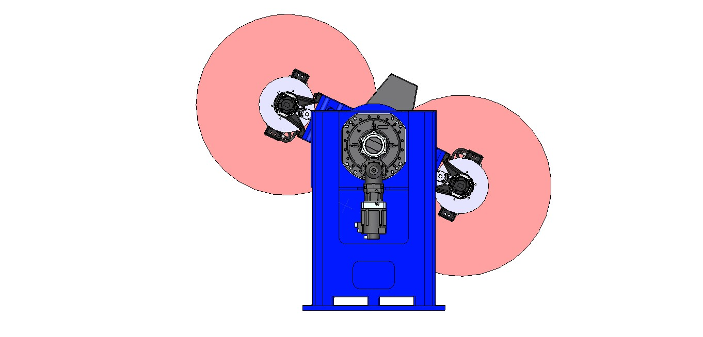
Roll
Roll
Confidential

Slide 5
Setup and Installation - Step 1
Eliminates discrepancies in Spread (critical), Offset, and Yaw (critical)
Chalk the floor. Mark the location of the outside edges of the striker plates(option) or columns as shown
Use chemical anchor and striker plates
Chalk lines
Confidential

Slide 6
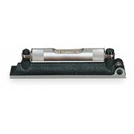
Setup and Installation - Step 2
Eliminates pitch (critical) and roll
Use Machinist’s level on column face plate
Use the base leveling bolts to level each column in both planes
Confidential

Slide 7
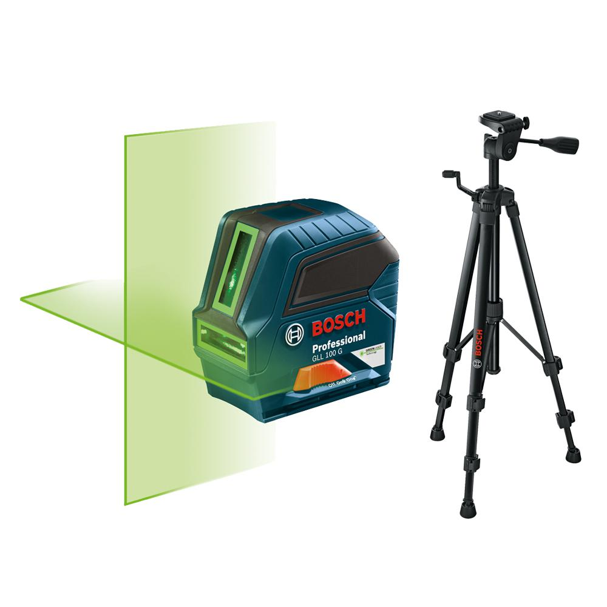
Setup and Installation - Step 3
Eliminates elevation issues
Uses height features on each column
Use a laser level to determine height of each column relative to the other
Adjust leveling bolts as required to get both columns at the same elevation
Verify and adjust column level
Confidential

Slide 8
Setup and installation – Step 4
ADJUST HARD STOPS!!!!!
On 1255 and larger positioners make sure the headstock and tailstock hard stops are hitting at the same time.

