Slide 2
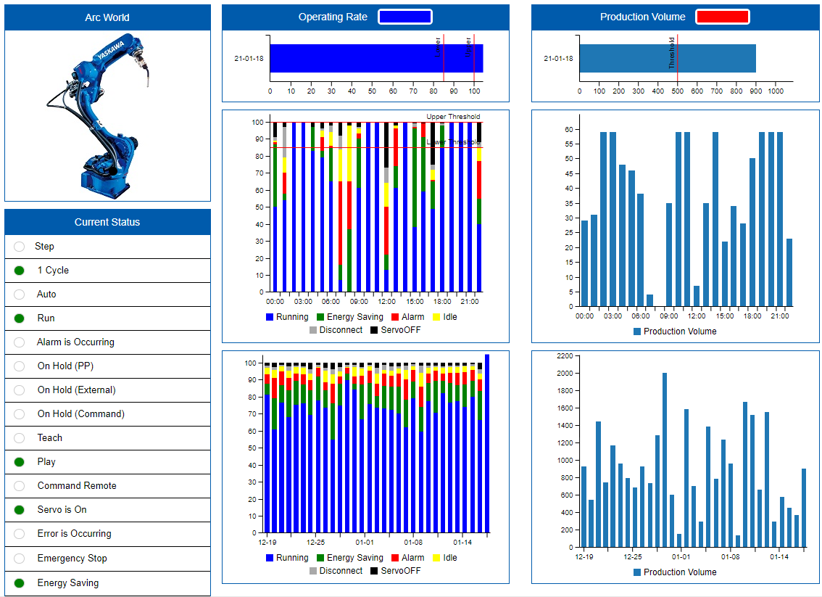
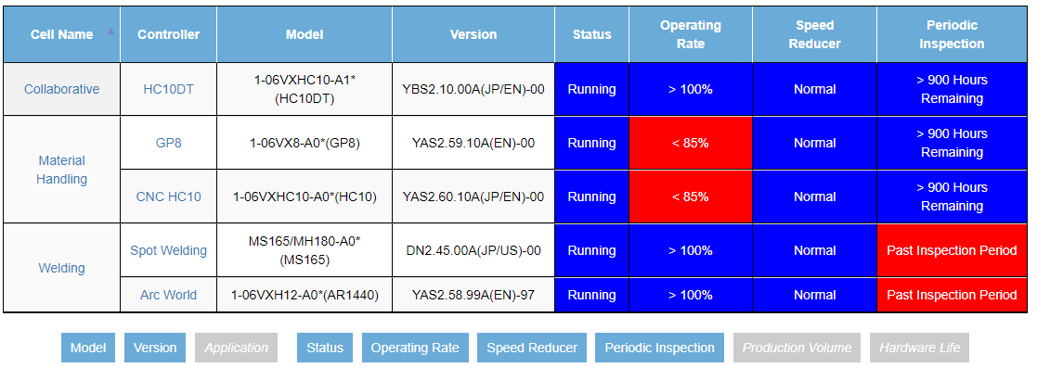
YASKAWA COCKPIT
Software Overview

Slide 3
CONTENT
OVERVIEW
What is YASKAWA Cockpit
i³-Mechatronics
KEY BENEFITS
Maintenance
Production Insights
Custom Analytics & UI
FUNDAMENTALS
Monitoring
Visualization
Extensibility
REQUIREMENTS
Controllers
Server
Network

Slide 4










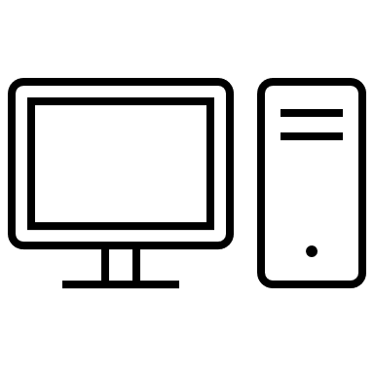

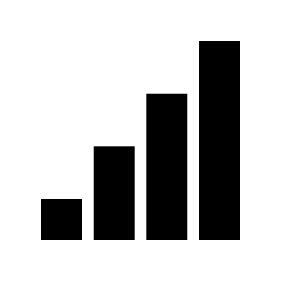

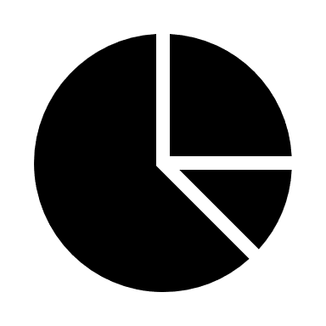


OVERVIEW
What is YASKAWA Cockpit?
Device Network
YASKAWA Cockpit (YCP) is a software platform for the ever-advancing Industrial Internet of Things (IIoT)
Edge-computing platform designed to collect and analyze data from a multitude of devices
Web-app that allows users to view data from anywhere on any device
Brings ability to modify and develop for the interface
Wired Network
VPN to Internet
Centralized Edge Server
Wi-Fi Network

Slide 5




OVERVIEW
Integrated
Connecting data driven devices and technologies together
Intelligent
Smart data analysis & learning (AI)
Innovative
Improving productivity through technological innovation
YASKAWA Cockpit incorporates the principles of i³-Mechatronics into its design philosophy to ensure compatibility with a wide range of systems and high-level analytics.

Slide 6

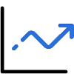

FUNDAMENTALS
Powered by
MONITORING
VISUALIZATION
EXTENSIBILITY

Slide 7
FUNDAMENTALS
Powered by
MONITORING
Historical Data
Alarm notifications
Asset information
System status
Production rates
Real-time data
VISUALIZATION
EXTENSIBILITY

Slide 8
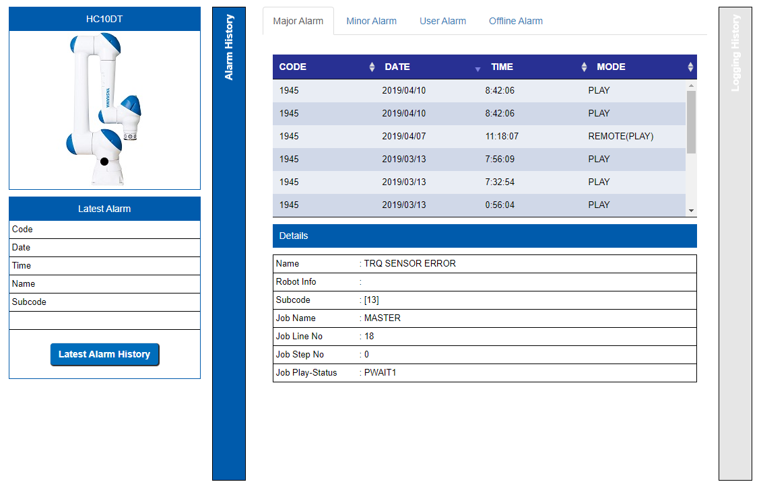
FUNDAMENTALS – MONITORING
Robot Alarms & Event Logging
When alarms occur know immediately via:
  The web interface
  Notifications emailed to the user
View detailed information for each alarm
View Alarm and Log history across all connected devices from one location

Slide 9
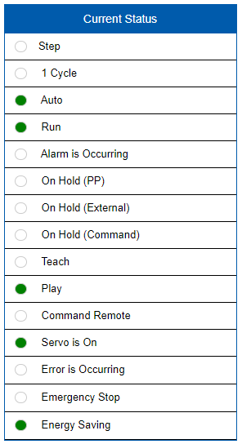
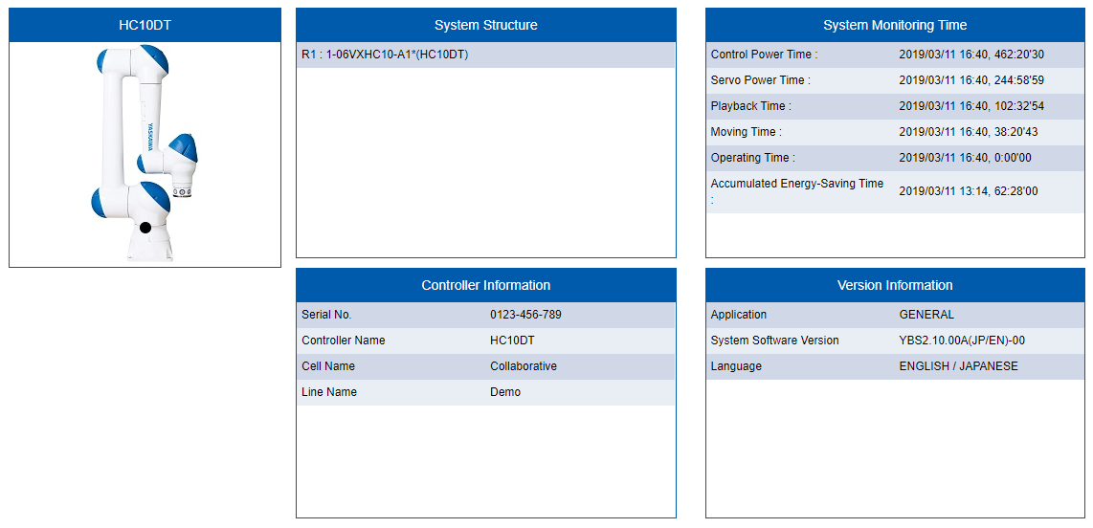
FUNDAMENTALS – MONITORING
Asset Information & System Status
General information about robot configurations
View the status of all robot in real-time
Remotely monitor the status of your production lines

Slide 10
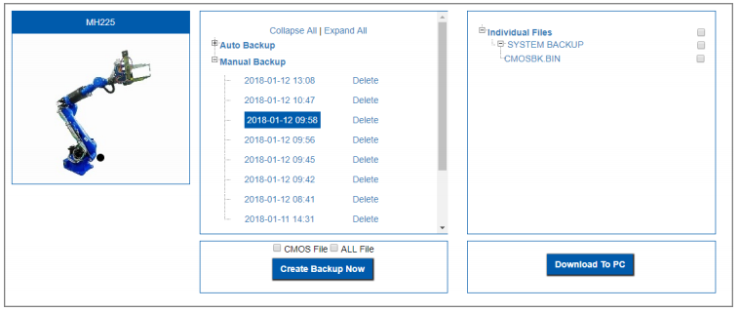
FUNDAMENTALS – MONITORING
Manual & Scheduled Remote Backups
Manually take backups of critical information
Schedule backups for each connected robot
No need to visit each robot to perform backups
Restore from backup files downloaded locally to the user’s PC

Slide 11
FUNDAMENTALS
Powered by
VISUALIZATION
Dashboards
Performance analytics
Graphical insights
Target thresholds
Digestible information
Predictive Maintenance
MONITORING
EXTENSIBILITY

Slide 12
FUNDAMENTALS – VISUALIZATION
Dashboards & Graphical Information
View multiple devices simultaneously
Quick insights on current operations
Track target performance rates
Understand past events with historical data

Slide 13
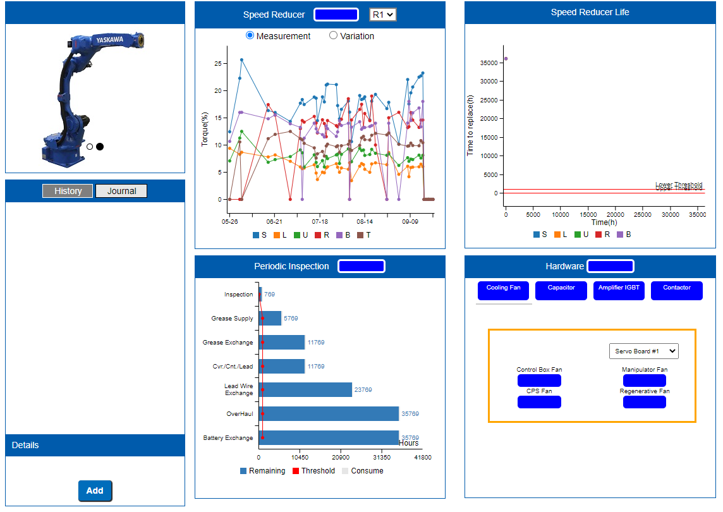
FUNDAMENTALS – VISUALIZATION
Predictive Maintenance
Track device health
Schedule maintenance before it’s required
Determine source of component failure
Track previous inspection & repairs

Slide 14
FUNDAMENTALS
Powered by
EXTENSIBILITY
Tailored data collection
Application analytics
OPC-UA & Web API
Data accessibility
Custom interfaces
Future of analytics
MONITORING
VISUALIZATION

Slide 15
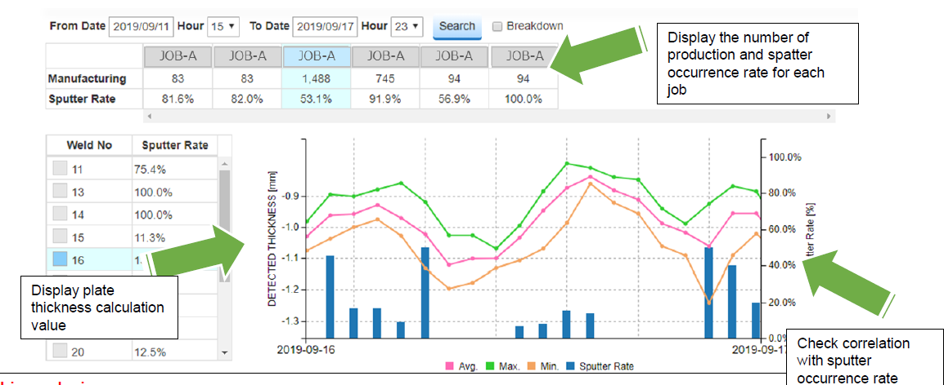
FUNDAMENTALS – EXTENSIBILITY
Tailored Application Insights
Analytics informed by the needs of the application
Increase production performance by detecting faults and areas for improvement
Custom interface to display the most vital information

Slide 16
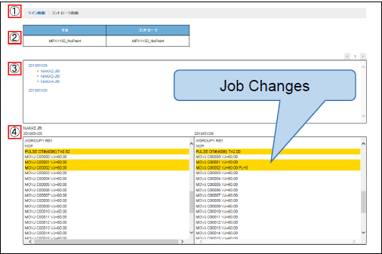
FUNDAMENTALS – EXTENSIBILITY
Customized Interfaces & Analytics
View the data in a way that best represents your application
Meaningful information based on custom data
Changes in application can be reflected in new updates to the interface

Slide 17




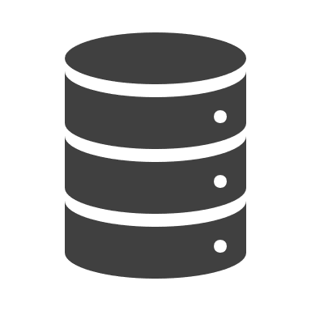
FUNDAMENTALS – EXTENSIBILITY
OPC-UA & Web API Data Access
Extract data from YCP for use with other software
Unified data format with OPC-UA
Support for customized development with Web API
Develop for the YCP interface
Custom data collection for a multitude of devices

Slide 18


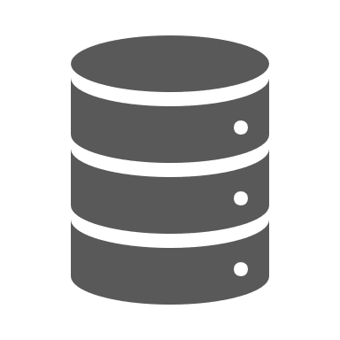



FUNDAMENTALS – EXTENSIBILITY
Support for the Future of “Artificial Intelligence” Enhancements
In many ways “AI” is the future of data analytics
Freedom of data transfer & remote analytics ensures YCP is ready for the future of “AI”
Cloud Computing and Machine Learning provide a bright future

Slide 19
FUNDAMENTALS
Powered by
MONITORING
VISUALIZATION
EXTENSIBILITY
Historical Data
Alarm notifications
Asset information
System status
Production rates
Real-time data
Dashboards
Performance analytics
Graphical insights
Target thresholds
Digestible information
Predictive Maintenance
Tailored data collection
Application analytics
OPC-UA & Web API
Data accessibility
Custom interfaces
Future of analytics

Slide 20

KEY BENEFITS
Maintenance
Periodic inspection rates help plan and schedule preventative maintenance
Answers the questions:
  Do I need to replace this component?
  When will I need to replace a component?
Avoiding unplanned downtime saves money and increases production capacity
Addons provide further maintenance monitoring insights
Graphic Designed by fullvector / Freepik

Slide 21
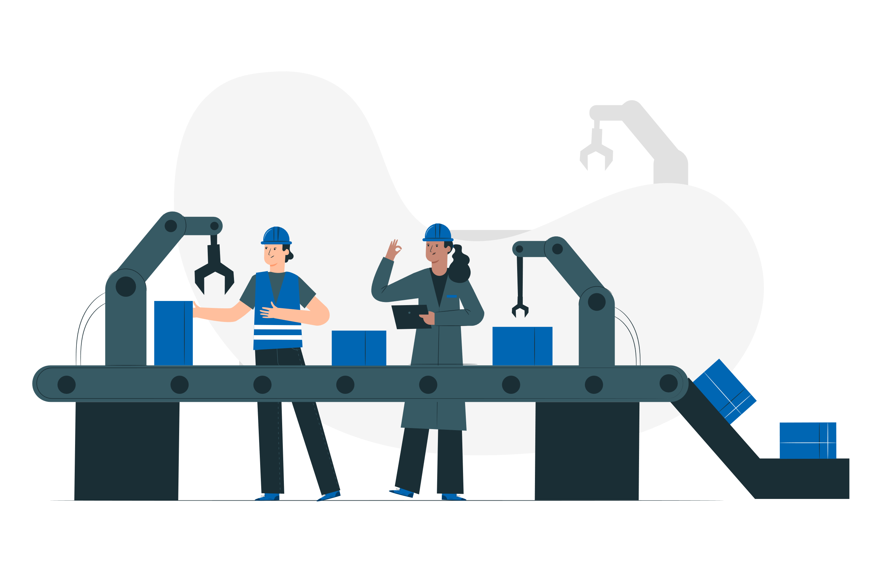
KEY BENEFITS
Production Insights
Track and respond to increases/decreases in performance
Know when target rates are being achieved
Know when a cell goes down and rectified thereafter
Eliminate down time by identify why or when it occurs
Graphic Designed by fullvector / Freepik

Slide 22
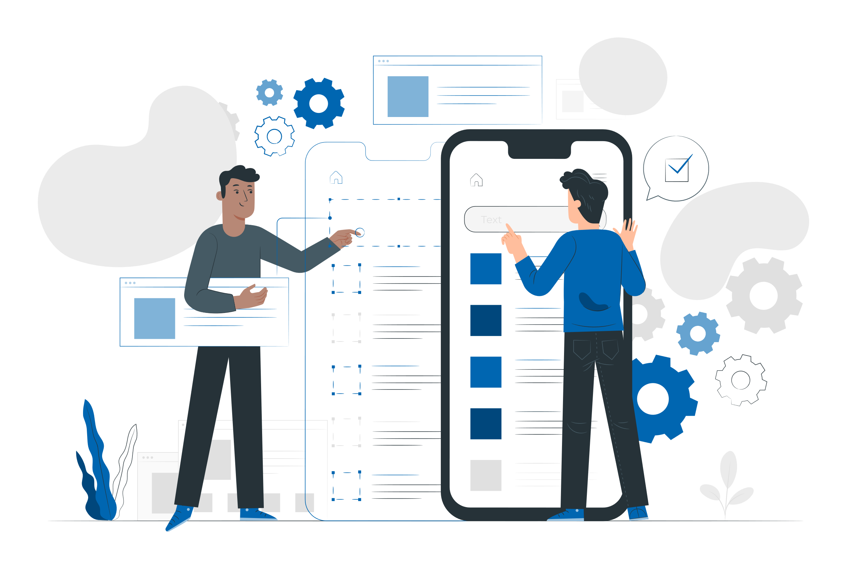
KEY BENEFITS
Custom UI & Analytics
The addon process promotes custom tailored analytics
User interfaces designed to best show the data how the user requires
Allows for future alterations to data collection and analysis for changes in production
Opportunities to integrate with the user’s existing backend systems (MES, ERP, etc.)
Graphic Designed by fullvector / Freepik

Slide 23
KEY BENEFITS
Respond & Change
Users or devices make changes to improve workflow:
Reduce errors
Find points of failure
Reduce downtime
Increase quality
Increase performance
Device Measurements
Connected devices on production lines, take measurements of real-world data.
How it Works
Review Information
Users or other software utilize the information to make more informed decisions.
Data Collection
External server collects data and store in a local database.
Data Analytics
Computation and analytics are performed locally, or in the cloud, to turn the data into valuable information.

Slide 24
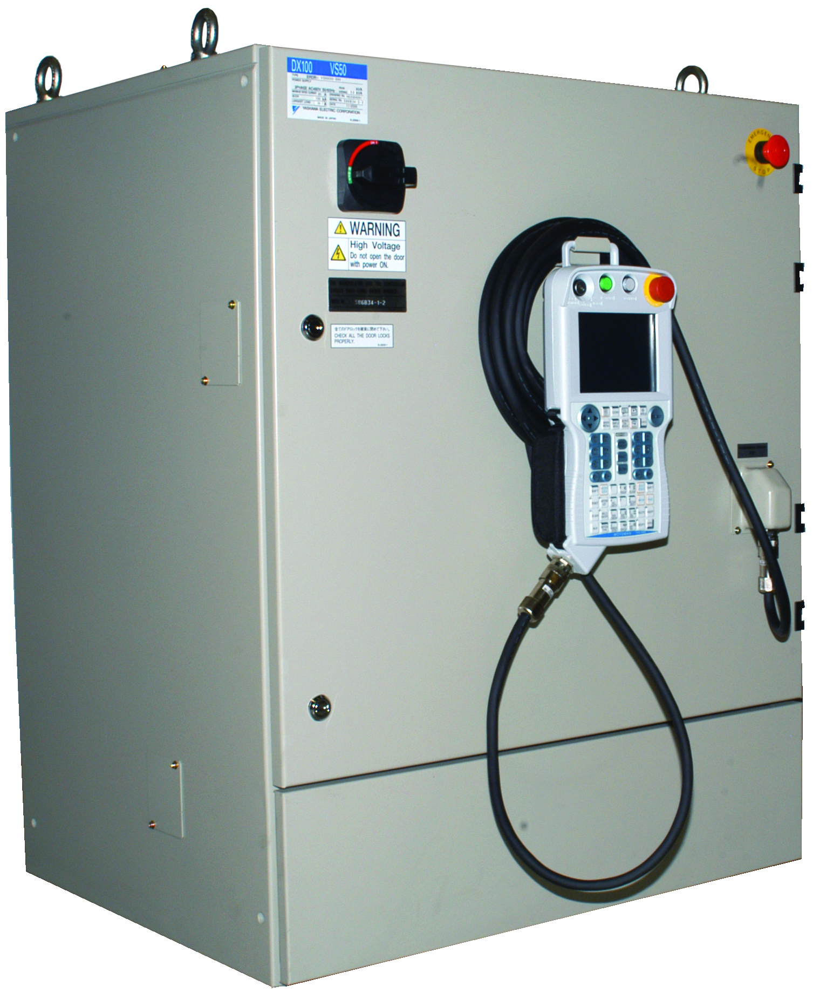
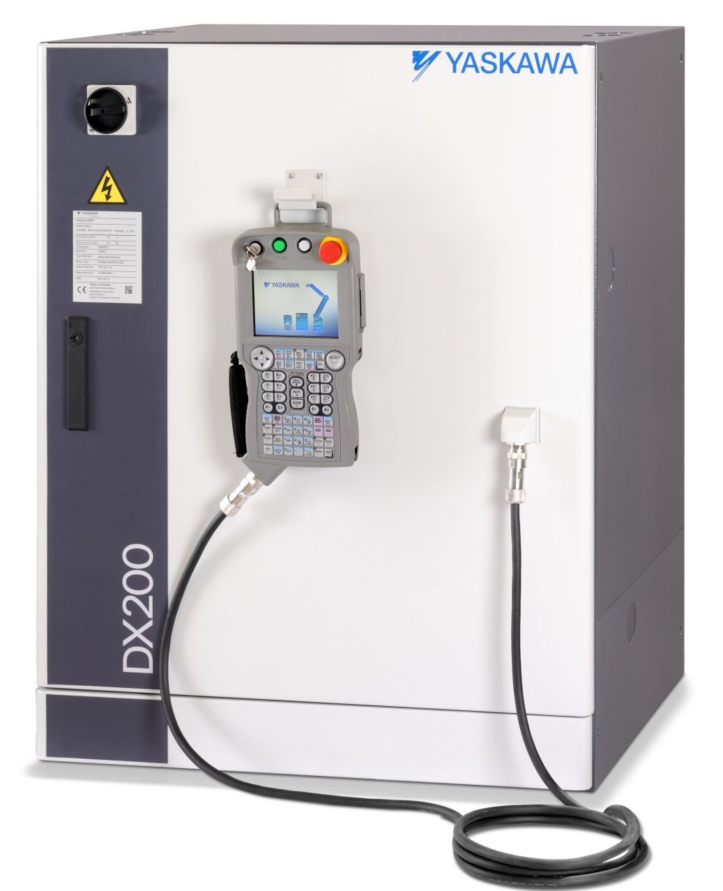
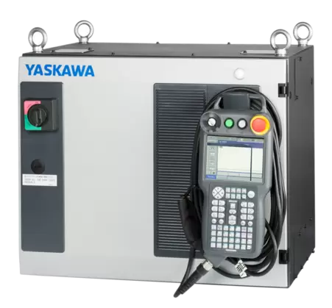
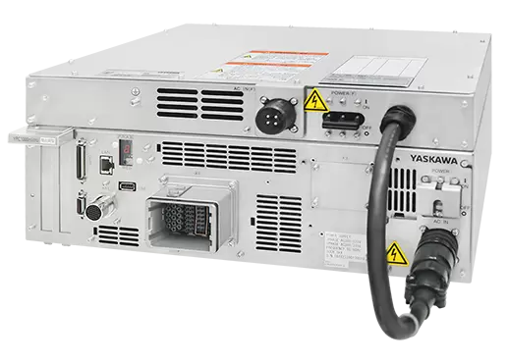
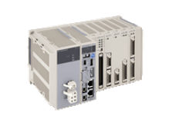
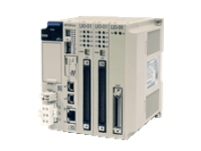
REQUIREMENTS
Supported Controllers
YCP supports the following robot controllers:
  DX100*
  DX200
The following Motion Controllers are also supported:
  MP3200
  MP3300
The optimal starting factory size is between 10-15 robot controllers
  YRC1000
  YRC1000 micro
Note: The suggested maximum number of connected devices (50) may differ based on the data collection, analytic requirements, and installed hardware.
*: Some reduced functionality

Slide 25
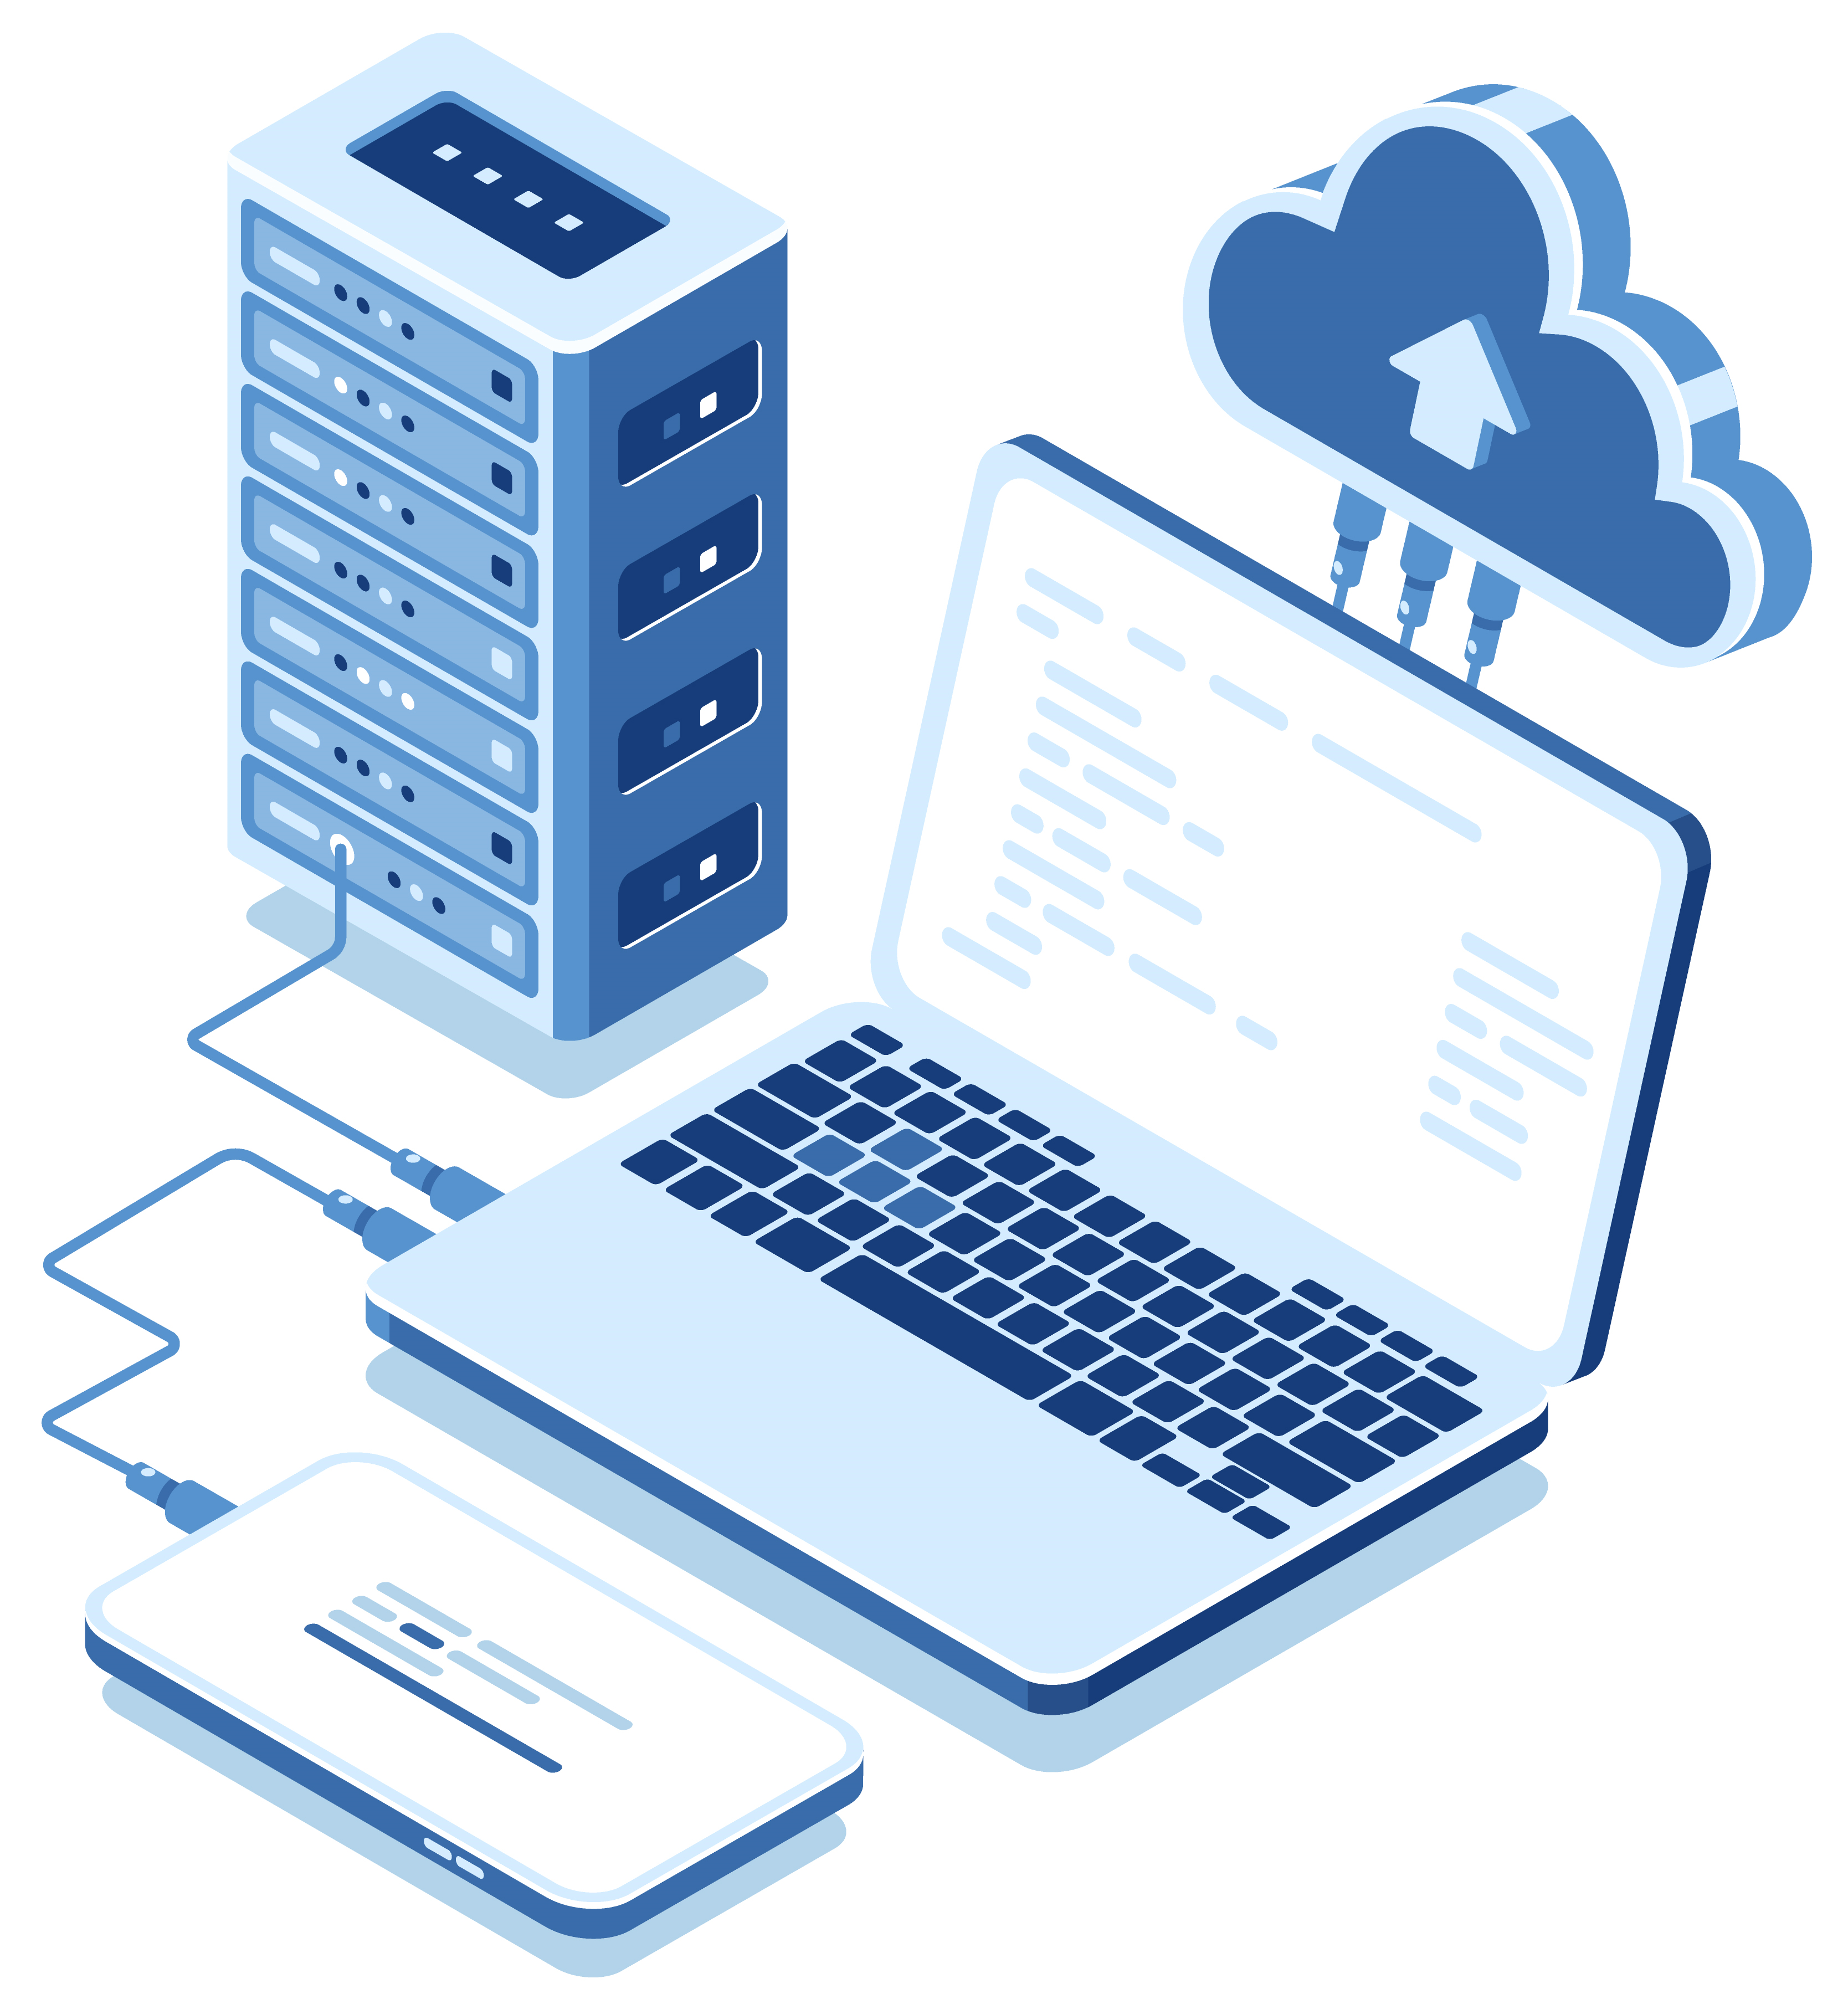
REQUIREMENTS
Server Hardware
OS
  Windows 10
  Windows Server 2016
CPU
  Core i7 4-Core Processor (or equivalent)
GPU
  Not required, but may be recommended based on analytics
Memory
  16GB RAM
  256GB SSD (Primary)
  1TB HD (Recommended as secondary)
Cloud Servers
A cloud-based server is not recommended due to the potential security risks to connected devices
Graphic Designed by fullvector / Freepik

Slide 26


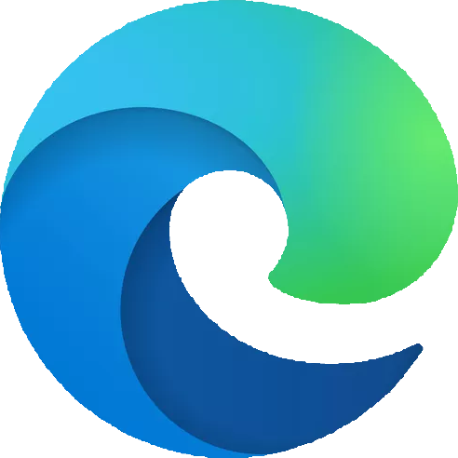

REQUIREMENTS
Network Setup
Device Network
Device Network
Wired Gigabit or 100Mb ethernet connection
NAT capable routers can be used to isolate work-cell networks
Wireless device connections are not suggested due to possible instabilities
Client Network
Wired or Wi-Fi network capable
Internet connections can be achieved via secure VPN access (or equivalent)
Desktop PC, Laptop, and mobile devices are supported
Supported Web-Browsers:
Wired Network
VPN to Internet
Centralized Edge Server
Wi-Fi Network

