Slide 2
CONVEYOR TRACKING TRAINING
Speaker Mikayla Wear | Date February 27, 2024

Slide 3
TRAINING SCHEDULE
  Introduction
  Hardware Installation
  Controller Setup
  INFORM Job Commands
  Applications

Slide 4
INTRODUCTION TO CONVEYOR TRACKING

Slide 5
WHAT IS CONVEYOR TRACKING?
Enables a robot to operate on an object that is continuously moving on a conveyor.
We need to know two things for conveyor tracking to function:
  Distance the conveyor has traveled
  Direction of conveyor travel
Available on Yaskawa Motoman controllers ERC and later.
Relevant Knowledge Center Articles
  https://knowledge.motoman.com/hc/en-us/articles/4408233115159-Conveyor-Tracking-Setup
  https://knowledge.motoman.com/hc/en-us/articles/4410008677271-Conveyor-Tracking-Training-Video

Slide 6
HARDWARE INSTALLATION

Slide 7
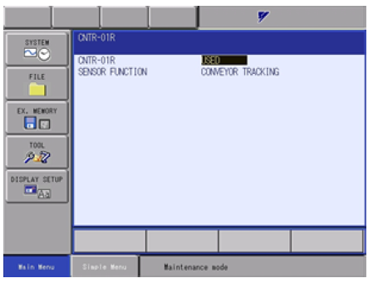
HARDWARE INSTALLATION
Encoder
Encoder Feedback Cable
Batch Trigger Signal (photoelectric sensor, PLC, I/O, etc.)
Splitter (if more than one robot tracks on conveyor)
Conveyor Tracking Board
  Boot into Maintenance Mode and select SYSTEM > SETUP > OPTION BOARD.
  Set to “USED” and then Cycle Power.

Slide 8
CONTROLLER SETUP

Slide 9
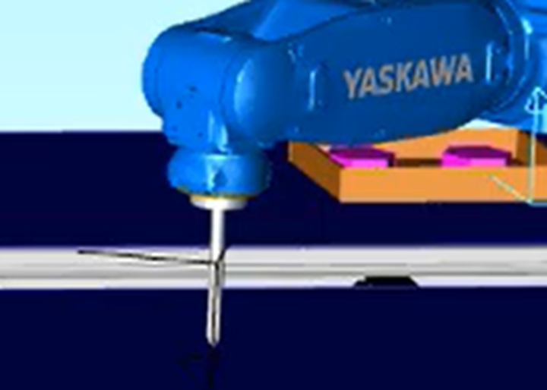
CONTROLLER SETUP
Teach Pointer TCP
Setup Conveyor Condition files
  Encoder Sign
  User Frame
  Conveyor Resolution
    Leading/Lagging
Setup Conveyor Supplemental Condition file
Teach Gripper TCP

Slide 10
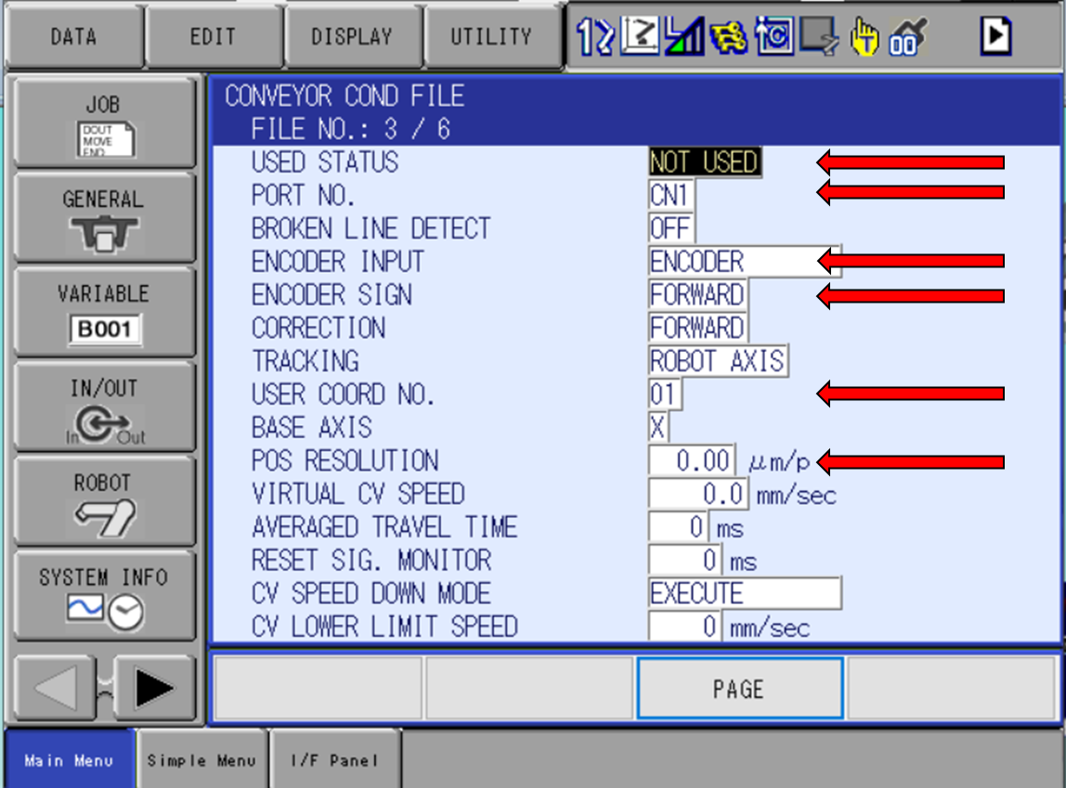
CONTROLLER SETUP
Teach Pointer TCP
Setup Conveyor Condition files
  Encoder Sign
  User Frame
  Conveyor Resolution
    Leading/Lagging
Setup Conveyor Supplemental Condition file
Teach Gripper TCP
For settings definitions, see the Conveyor Synchronized Function manual.

Slide 11
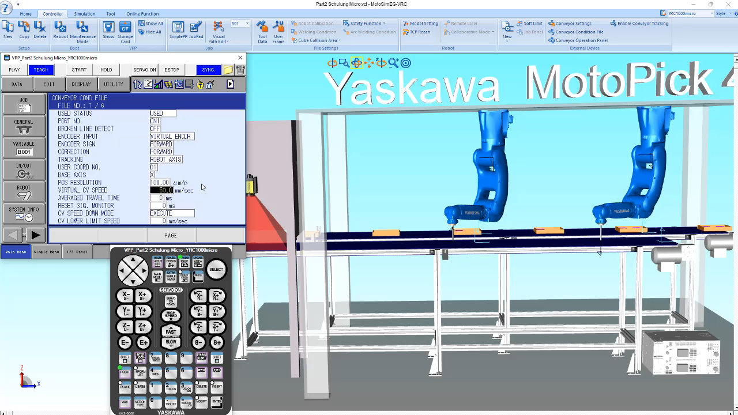
CONTROLLER SETUP
Teach Pointer TCP
Setup Conveyor Condition files
  Encoder Sign
  User Frame
  Conveyor Resolution
    Leading/Lagging
Setup Conveyor Supplemental Condition file
Teach Gripper TCP

Slide 12
CONTROLLER SETUP
Teach Pointer TCP
Setup Conveyor Condition files
  Encoder Sign
  User Frame
  Conveyor Resolution
    Leading/Lagging
Setup Conveyor Supplemental Condition file
Teach Gripper TCP
For settings definitions, see the Conveyor Synchronized Function manual.

Slide 13
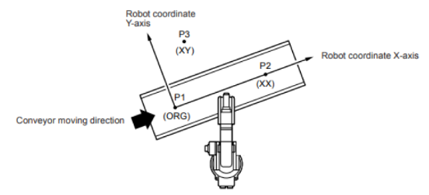
CONTROLLER SETUP
Teach Pointer TCP
Setup Conveyor Condition files
  Encoder Sign
  User Frame
  Conveyor Resolution
    Leading/Lagging
Setup Conveyor Supplemental Condition file
Teach Gripper TCP

Slide 14
CONTROLLER SETUP
Teach Pointer TCP
Setup Conveyor Condition files
  Encoder Sign
  User Frame
  Conveyor Resolution
    Leading/Lagging
Setup Conveyor Supplemental Condition file
Teach Gripper TCP
For settings definitions, see the Conveyor Synchronized Function manual.

Slide 15
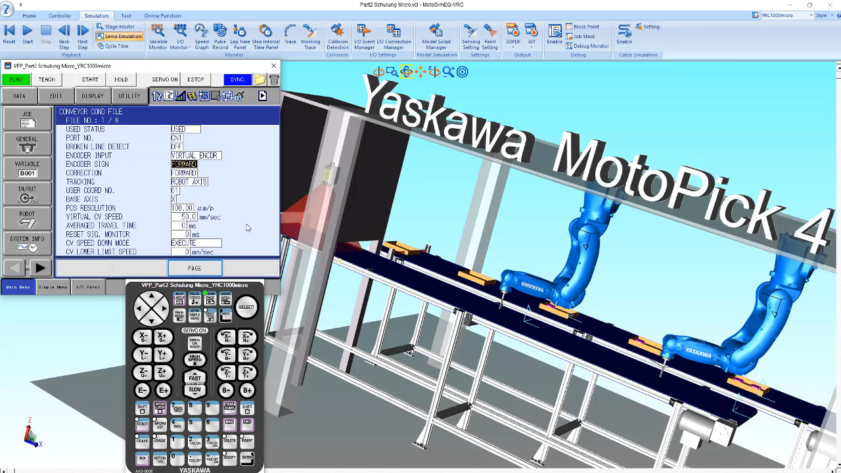

CONTROLLER SETUP
Teach Pointer TCP
Setup Conveyor Condition files
  Encoder Sign
  User Frame
  Conveyor Resolution
    Leading/Lagging
Setup Conveyor Supplemental Condition file
Teach Gripper TCP

Slide 16
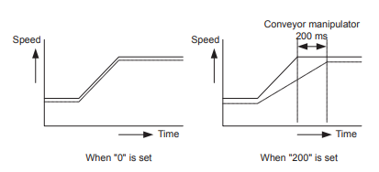
CONTROLLER SETUP
Teach Pointer TCP
Setup Conveyor Condition files
  Encoder Sign
  User Frame
  Conveyor Resolution
    Leading/Lagging
Setup Conveyor Supplemental Condition file
Teach Gripper TCP
For settings definitions, see the Conveyor Synchronized Function manual.

Slide 17
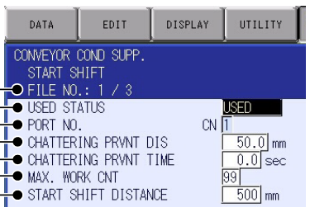
CONTROLLER SETUP
Teach Pointer TCP
Setup Conveyor Condition files
  Encoder Sign
  User Frame
  Conveyor Resolution
    Leading/Lagging
Setup Conveyor Supplemental Condition file
Teach Gripper TCP
For settings definitions, see the Conveyor Synchronized Function manual.

Slide 18
CONTROLLER SETUP
Teach Pointer TCP
Setup Conveyor Condition files
  Encoder Sign
  User Frame
  Conveyor Resolution
    Leading/Lagging
Setup Conveyor Supplemental Condition file
Teach Gripper TCP

Slide 19
INFORM JOB COMMANDS

Slide 20
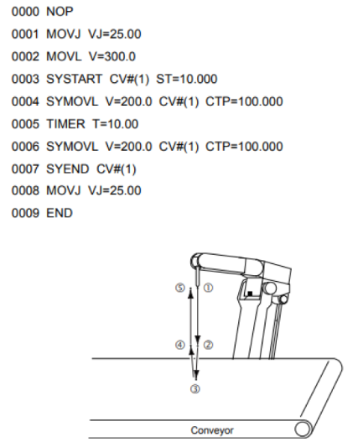
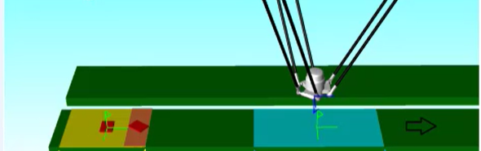
ROBOT JOB EXAMPLE
Starts conveyor synchronization
Synchronous robot movements
Ends conveyor synchronization
CTP
STP
OL

Slide 21

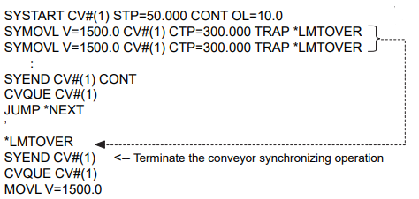
OTHER INSTRUCTIONS
CVQUE Command (Available with Shift Functions)
  Needed for applications where you are tracking more than one product at a time.
  Moves to the next tracking element in the CV Shift Monitor list.
Continuous Operation (Available on FS100 and YRC1000)
  TRAP Tag
    In addition to SYSTART
      Minimizes processing time required for if a workpiece’s conveyor position exceeds the STP and OL values and conveyor synchronization is not executed.
    In addition to SYMOVL
      Discontinues the conveyor synchronization in the event of an “overlimit” without alarming.

Slide 22
OTHER INSTRUCTIONS
  CONT Tag
    In addition to SYSTART
      Minimizes processing time between each conveyor synchronization cycle without interruption.
    In addition to SYEND
      Minimizes processing time after each conveyor synchronization cycle by eliminating the need to reset the conveyor’s home position each time.

Slide 23
APPLICATIONS
Single robot and workpieces are in consistent locations on conveyor.
  Conveyor Synchronization (ERC or later)
Single robot and workpieces are in consistent locations on conveyor, but home position limit switch cannot be installed near robot.
  Conveyor Synchronization with Shift Functions (DX100 or later)
Single robot but workpieces are not in consistent locations on conveyor.
  Conveyor Synchronization with MotoSight 2D (DX100 or later)
  https://knowledge.motoman.com/hc/en-us/articles/7135659410455-MotoSight-2D-with-Conveyor-Tracking-Setup-Guide
Multiple robots with load sharing and pick/place patterns and MORE!
  MotoPick 4.0 (FS100, YRC1000, YRC1000micro)
  https://knowledge.motoman.com/hc/en-us/sections/17328185212055-MotoPick

Slide 24
Technical Support Hotline 937.847.3200

