Slide 1
YRC 1000
MagSwitch
MagMaster
Setup
Aug 4, 2023

Slide 2
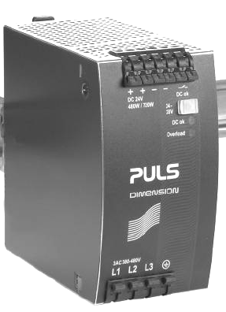
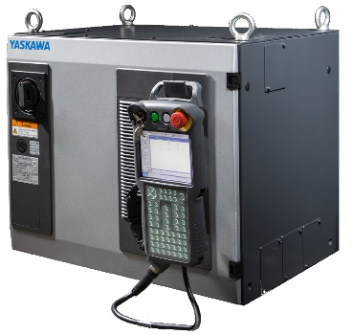
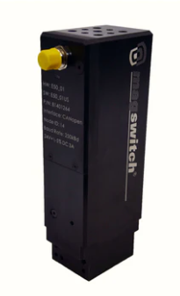
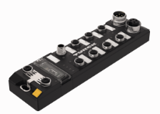
YRC Magmaster Hardware
Ethernet IP
Serial
24VDC
24VDC
YRC1000
E-Series Magnet
LAN2
MagMaster 4001 Com
MagSwitch P/N 8800826

Slide 3
YRC Magswitch Magmaster Device Setup
Set YRC1000 IP Address
Verify YRC1000 Ethernet IP option enabled
Add Magswitch Magmaster 4001 com module to device list
Add Magswitch Magmaster 4001 com module to scan list
YRC1000I/O allocation
Set Magswitch Magmaster IP address
Set Magswitch Magnet Node address (Multiple magnet systems)
Verify hardware connection
Verify device communication
Test I/O
Magmaster magnet sequences
YRFC1000 Files
Device Communication Status

Slide 4
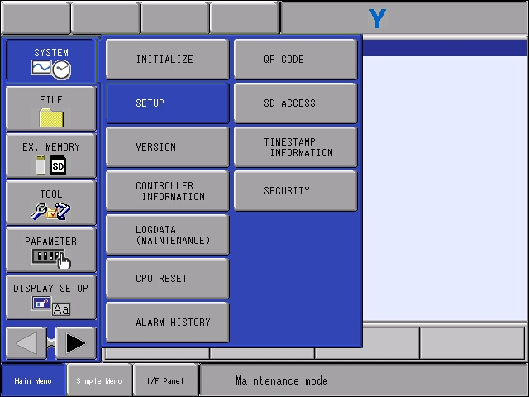
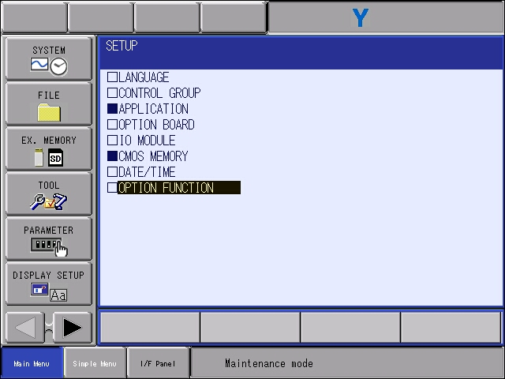
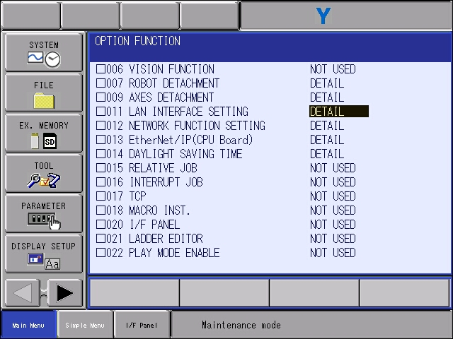
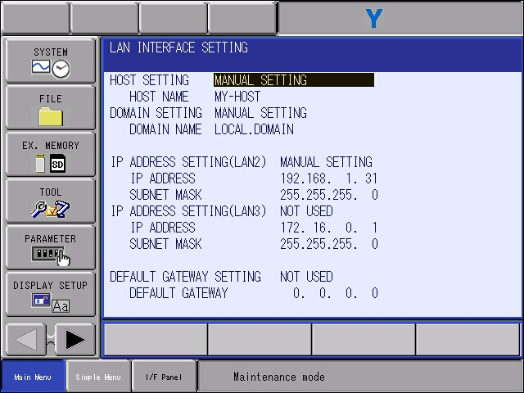
Set YRC1000 IP Address
Reboot controller to maintenance mode
Change security mode to Safety Mode
    Password – 5555555555555555
Select system, then setup, then option function
Select LAN Interface Setting

Slide 5
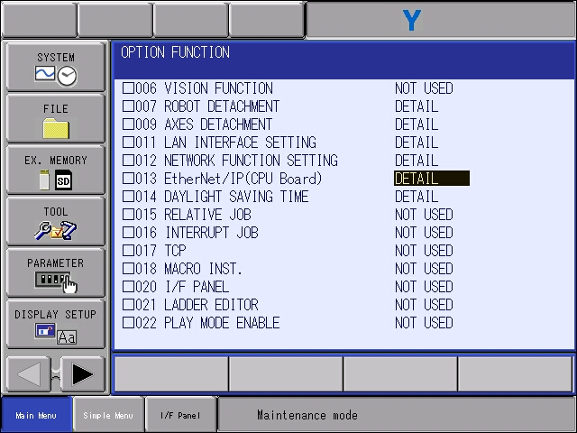
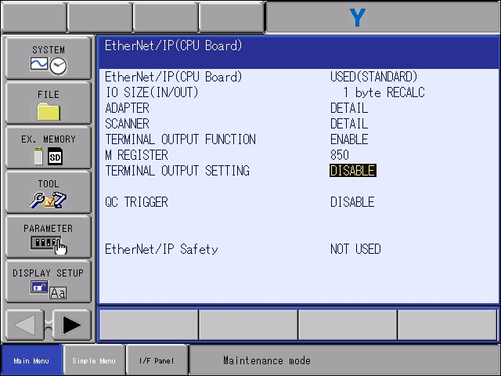
Verify Ethernet IP option is enabled
From Option Function Menu, Select Ethernet/IP (CPU Board)
Verify setting = Used
If not used, Call Yaskawa Motoman Robotics at (937) 847-3200. Reference Part number 181173-1

Slide 6
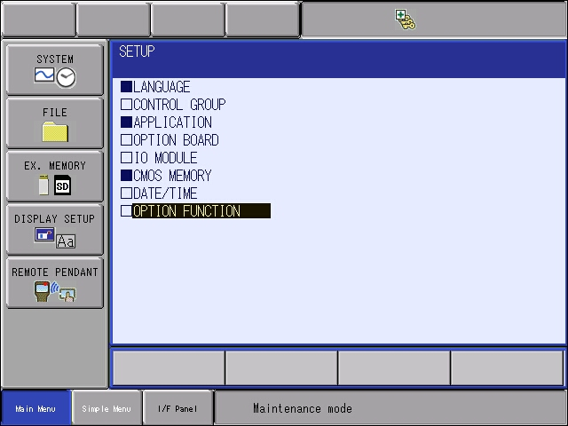
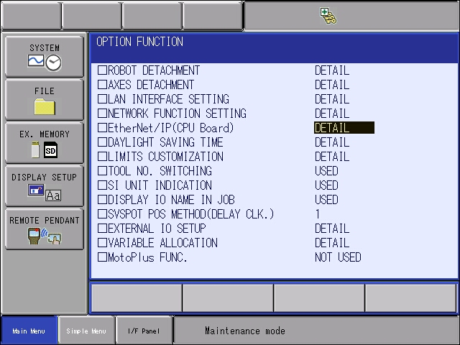
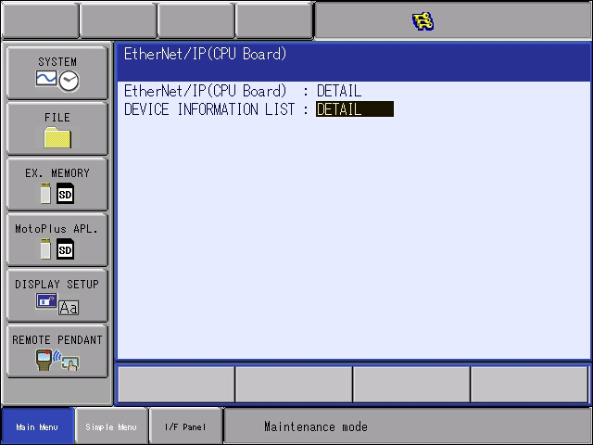

Add device to device list – Mag Master
Reboot controller to maintenance mode
Change security mode to Safety Mode
    Password – 5555555555555555
Select option function
Select EtherNet/IP (CPU Board)
Select device information list – Detail
Device EDS not required for YRC1000 Setup

Slide 7
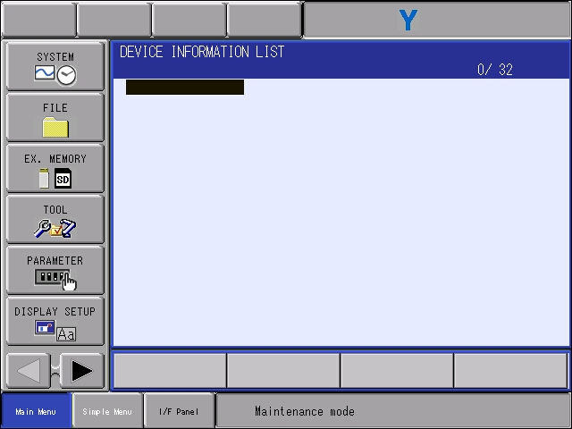
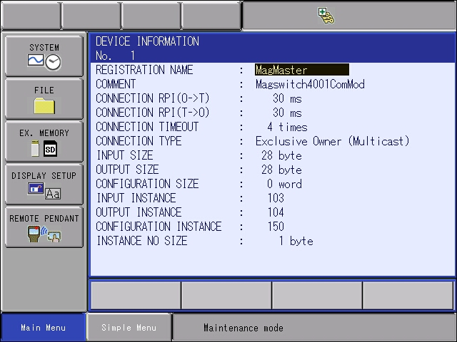

YRC ethernet IP Device Setup – Mag Master
Select an open space
Enter the device Information from manufacturer
  Registration name – name to appear in scanlist
  Connection RPI – Device Update rate, system dependent. A good starting point is 30ms
  Connection type – Exclusive owner
  Input instance
  Input size
  Output instance
  Output size
  Configuration Instance
  Configuration Size

Slide 8
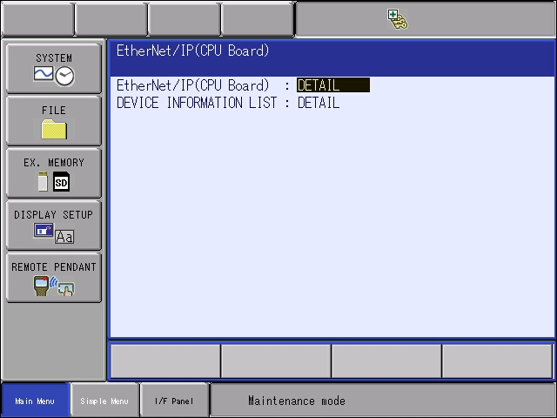
YRC ethernet IP Device Setup – Add device to scanlist
Reboot controller to maintenance mode
Change security mode to Safety Mode
    Password – 5555555555555555
Select option function
Select EtherNet/IP (CPU Board)
Select EtherNet/Ip (CPU Board)

Slide 9
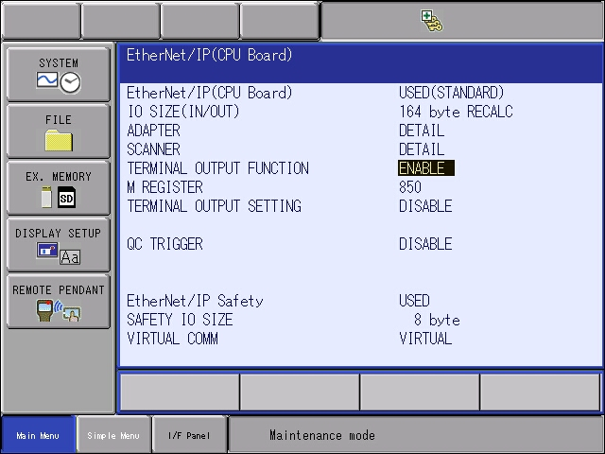
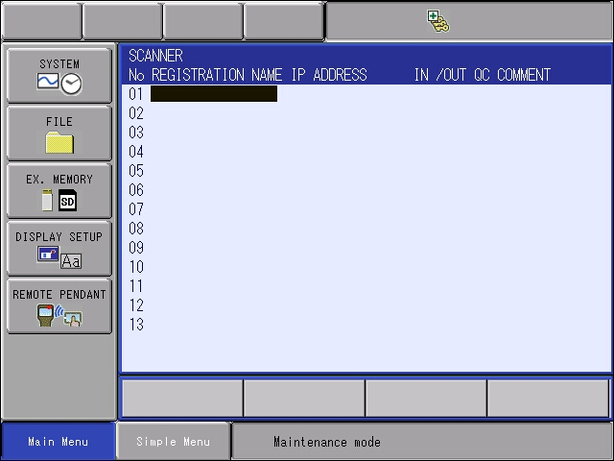
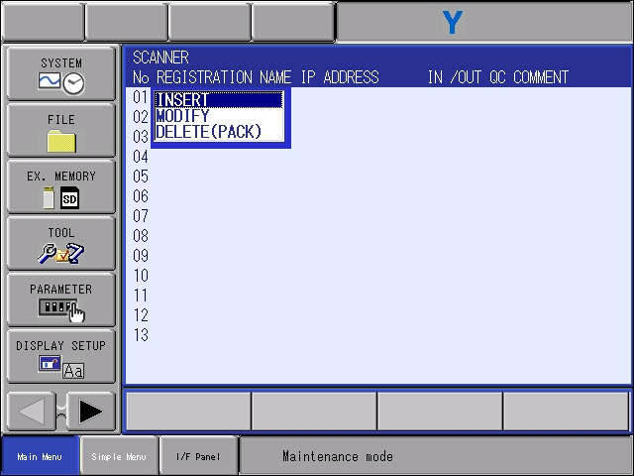
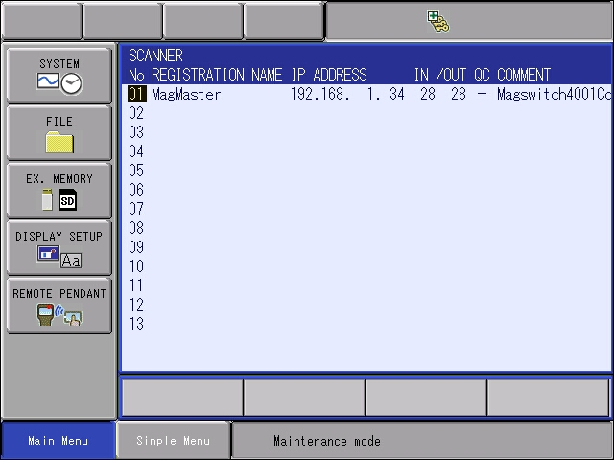
YRC ethernet IP Device Setup – Add device to scan list
Select scanner
Select scanner slot for device (1-16)
Select Insert
Pick device from device list
Set Ip Address for device (and quick connect if functionality is required/available)

Slide 10
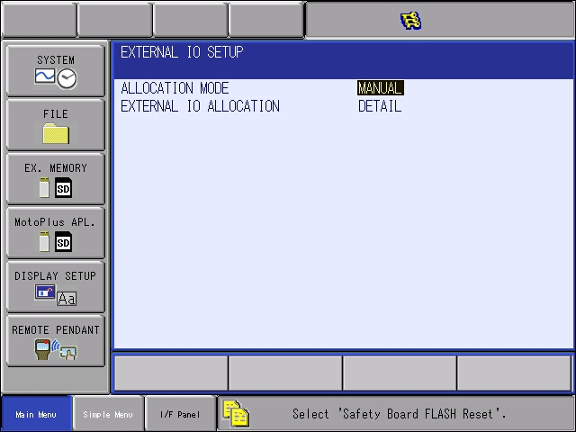
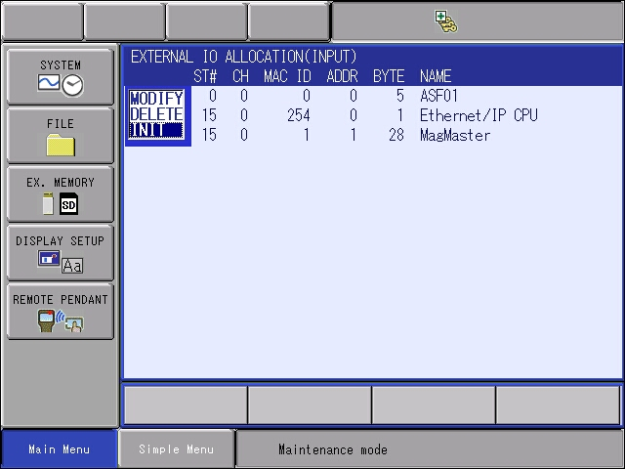
YRC ethernet IP Device Setup – I/O allocation
Allows assignment of device to specific external inputs / outputs.
Devices mapping
  Starting at In/Out 201, for example
Select manual allocation mode
Select external IO allocation detail
Initialize input allocation if required
  Select an ext input address, then Init

Slide 11
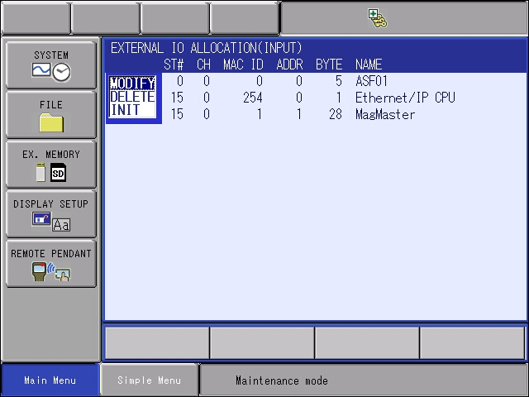
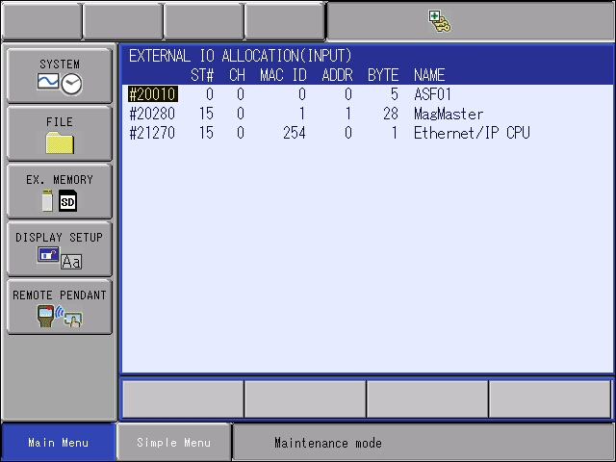
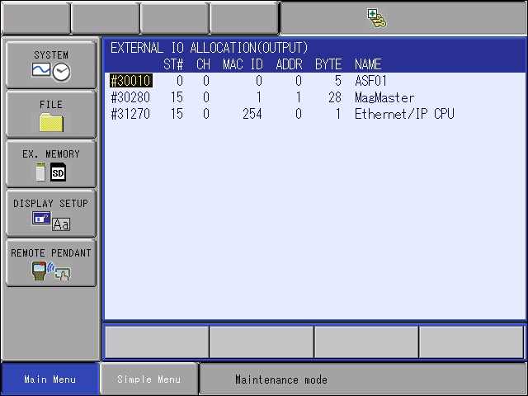
YRC ethernet IP Device Setup – I/O allocation
  Assign MagMaster I/O
    Inputs
      Select MagMaster external input
      Select Modify
      Enter 20280 (for general Input 201)
      Select Ethernet/IP CPU
      Select Modify
      Enter 21270 (for general input 993)
      Standard Ethernet IP Status Inputs
    Outputs
      Select MagMaster external output
      Select Modify
      Enter 30280 (for general Input 201)
      Select Ethernet/IP CPU
      Select Modify
      Enter 31270 (for general input 993)

Slide 12
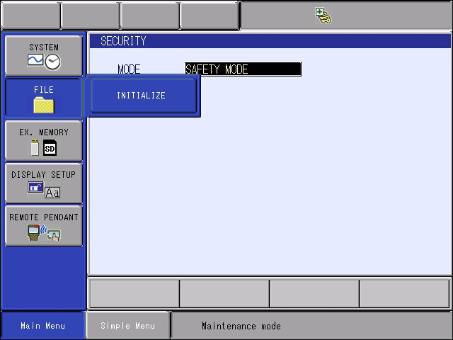
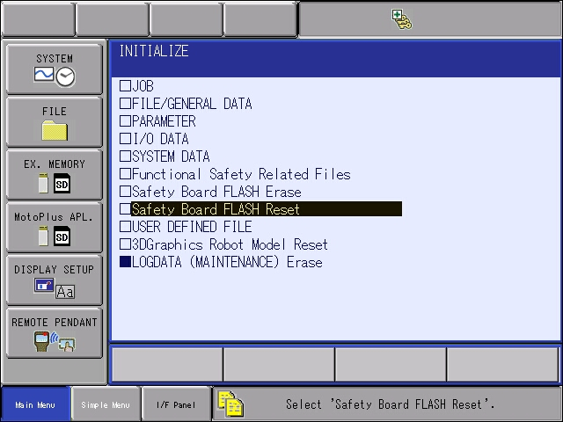
YRC ethernet IP Device Setup – I/O allocation
  Select File, Intilaize
  Safety board Flash Reset
  Cycle power for online mode, or use the CPU reset option under the system menu.

Slide 13

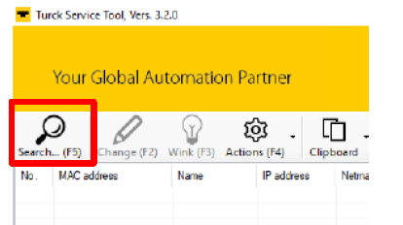
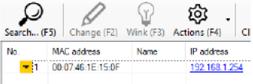
YRC Magmaster – Set Device IP Address
  Turck PC setup tool required located at
https://www.turck.us/en/product/SW_Turck%20Service%20Tool
1) Once installed, connect Magaster block to PC via ethernet and press search button.
2) The network will report information for devices
3) Select the device
4) From the change bar (F2) Change IP address, subnet mask, and gateway as needed.
  192.168.1.101 is the first standard available address
  192.168.1.34 is for example only
5) Cycle power on the Magmaster block

Slide 14
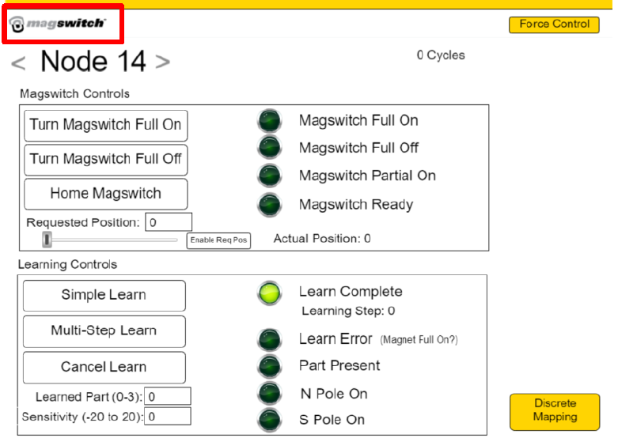
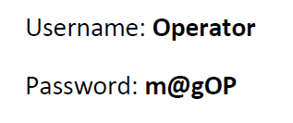
YRC Magmaster – Set Magnet Node (multiple magnet system)
Connect E-Series Magnet to Magmaster. Apply power to system. Magnet should have a green and blue flashing led.
  Connect only one magnet at this time
Connect laptop to Ethernet network, set IP address, launch web browser with IP address of MagMaster unit/port (192.168.1.34:8080)
Login with credentials
Login Prompt

Slide 15
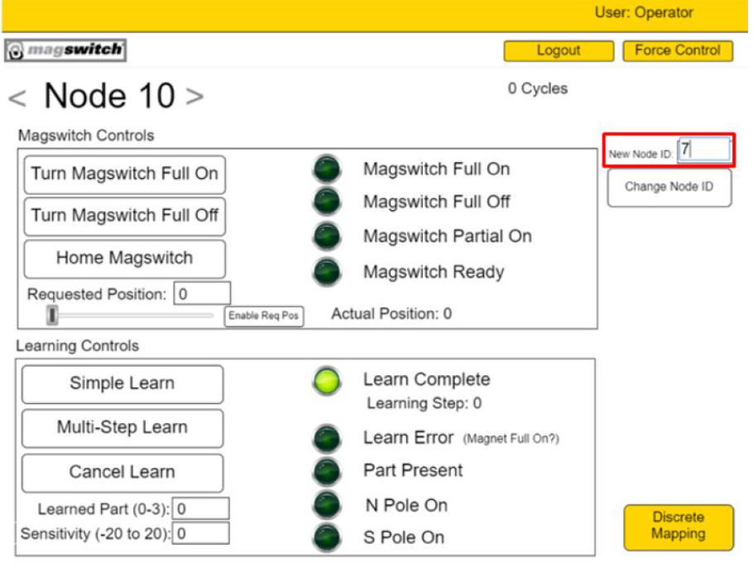
YRC Magmaster – Set Magnet Node (multiple magnet system)
Enter Node ID for magnet
  First magnet – node1
  Second magnet – node2
When new node id is entered, the value will be written to the magnet. Use the force control box if value has not been written after a few seconds.
Repeat process with additional magnets connecting one at a time to the Magmaster

Slide 16
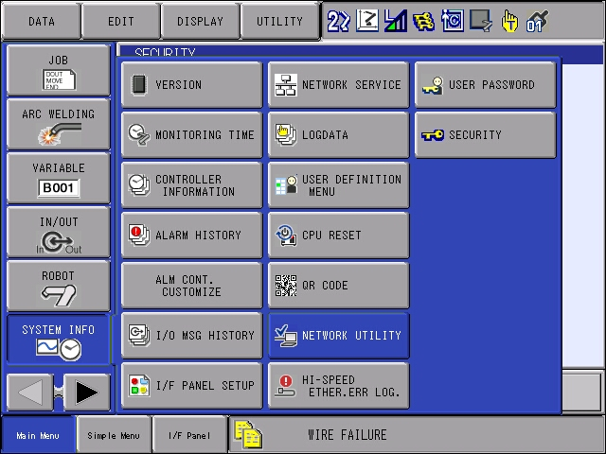
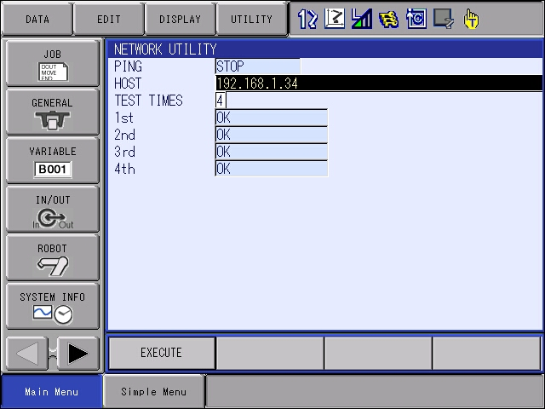
EtherNet IP Device Setup – Verify Hardware Connection
Change security mode to management mode
Under system info, select the network utility
Enter device IP address in the HOST box
Press the execute button
Hardware connection is good when there is an “OK” result
Verify Ethernet cable to device when “NG” result is displayed.
Similar to using a PC cmd prompt to ping a device

Slide 17
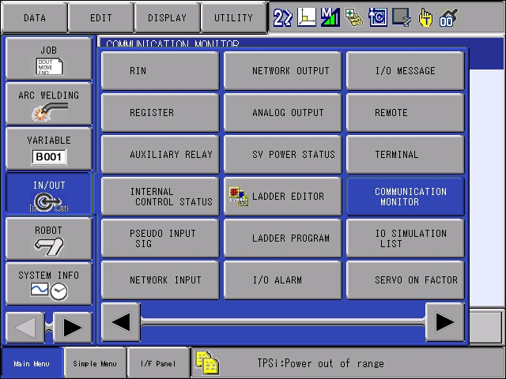
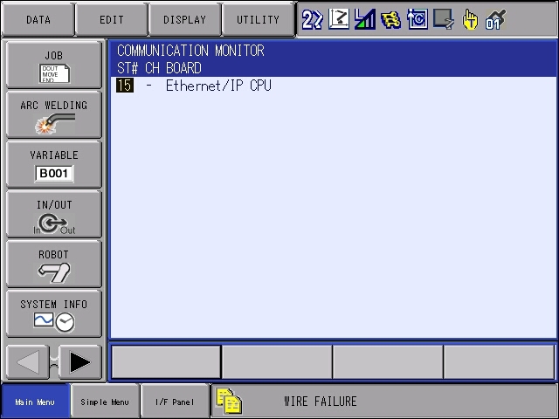
EtherNet IP Device Setup – Verify Device Communication
Change security mode to management mode
Under In/Out, select communication monitor
Select ST# - 15 Ethernet/IP CPU
Device Scanlist is displayed

Slide 18
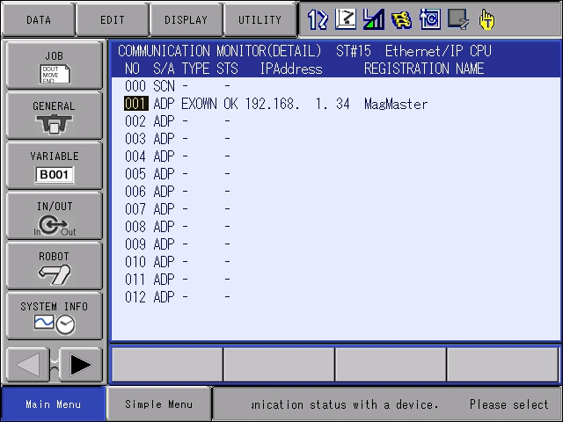
EtherNet IP Device Setup – Verify Device Communication
Communication status is displayed in the STS column
If NG, curser to the device and press select for diagnostic information
Troubleshooting: Verify device I/O size in setup, ensure power is on all components in the device (both inputs and outputs)

Slide 19
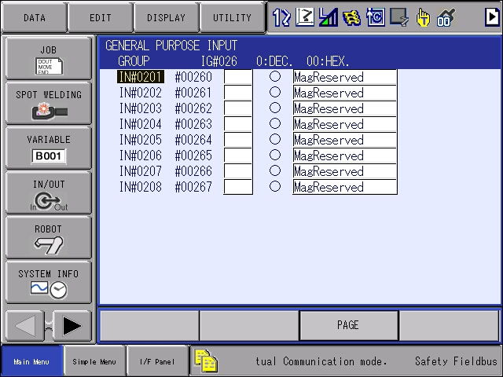
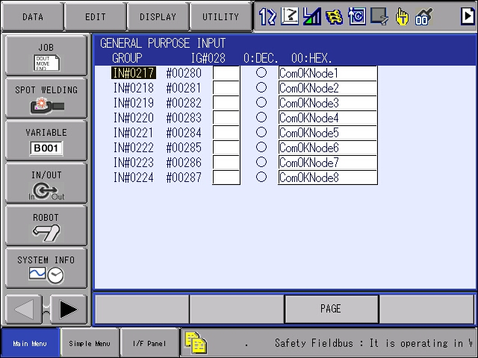

Magmaster – Test I/O
From the In/Out menu, select general purpose inputs
Select an input number and type 201
Indicator will be solid when input is on
Press the page key for the next group of inputs

Slide 20
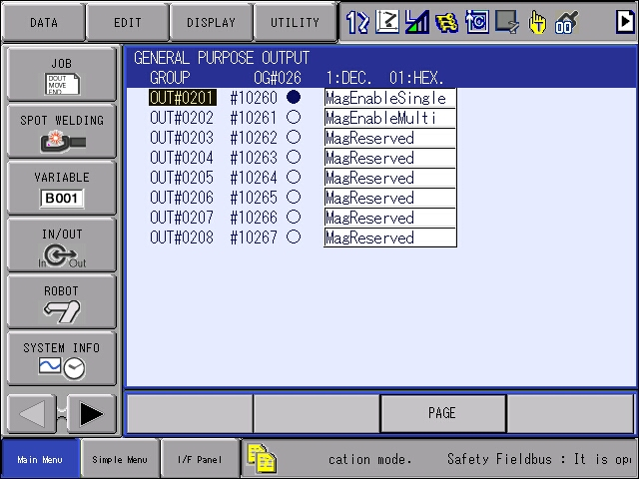
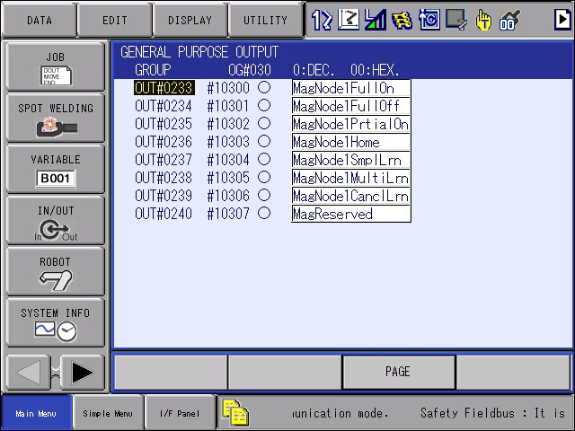
Magmaster – Test I/O
From the In/Out menu, select general purpose outputs
Select an output number and type 201
Curser to indicator
Press pendant interlock and select buttons at the same time in teach mode to turn on/off output.
Press the page key for the next group of outputs

Slide 21
Magmaster – Power Up sequence single magnet
Magnet
Robot
Turn power on Magmaster controller
Verify serial connection to magnet(s)
Verify aux power cable (if magnet supports) has power on correct pins
Turn power on robot controller
Turn on Output 201 (Single magnet enable)
Verify Input 230 is on (ComOK Node 14) magnet) (node 14 is default)
Turn on Output 236 (Home)
Wait for Input 236 (Ready)
Turn Off Output 236 (Home)
Notes:
Power up time is 5-8 seconds depending on magnet
When using a tool changer, disconnect power from magnet before uncoupling/coupling tool changer

Slide 22
Magmaster – Single Magnet Control
Magnet Full On
Magnet Partial On
Magnet Full Off
Turn off output 234 (Full Off)
Turn off output 235 (Partial On)
Turn on output 233 (Full On)
Wait for inputs…
233 Full On
240 Part present (selected) ON
241 North pole on
242 South pole on
Turn off output 234 (Full Off)
Turn off output 233 (Full On)
Turn on % Output 249-255 On
Wait for % input 249-255 On
Turn on output 233 (Partial On)
Wait for inputs…
235 Partial On
241 North pole on
242 South pole on
Turn off output 233 (Full On)
Turn off output 235 (Partial On)
Turn on output 234 (Full Off)
Wait for inputs…
234 Full Off On
240 Part present (selected) Off
241 North pole off
242 South pole off
Notes:
Part present must be taught first via the learn function.
Part present input only functions with magnet full on output or 100% partial on.
If the North or South pole input is on without the part present, the part has not been learned or a double blank has been detected. (Change in magnetic pattern from taught pattern for part)

Slide 23
Magmaster – Simple Learn function
Learn Sequence
Error Recovery
Turn on/off output 265 (Learn ID Bit1)
Turn on/off output 266 (Learn ID Bit2)
Turn on output 237 (Simple Learn)
Wait for inputs…
237 Learn Complete or
238 Learn Error
Turn off output 237 (Simple Learn)
Turn on output 239 (Cancel Learn)
Wait on input 239 (Learn Cancel)
Turn off output 239 (Cancel Learn)
Notes:
When turning magnet full on, outputs 265/266 select the learn ID (Part) for part present reference
Learn sequence must be done with magnet full on or partial on with 100%

Slide 24
Magmaster – Multiple Magnet Control
Magnet
Turn power on robot controller
Verify Input 217 is on (ComOK Node 1 magnet)
Verify Input 218 is on (ComOK Node 2 magnet)
Turn On Output 202 (Multi magnet enable)
Turn On Output 236 (Home) Magnet1
Wait for Input 236 (Ready) Magnet1
Turn Off Output 236 (Home) Magnet1
Turn on Output 332 (Home) Magnet2
Turn Off Output 332 (Home) Magnet2
Turn Off Output 332 (Home) Magnet2
Turn power on magmaster controller
Verify serial connection to magnet(s)
Verify aux power cable (if magnet supports) has power on correct pins
Notes:
Power up time is 5-8 seconds depending on magnet
When using a tool changer, disconnect power from magnet before uncoupling/coupling tool changer
Second magnet control is the same at the first, I/O is offset by 12 bytes. Set node 1 & node 2 for magnets.

Slide 25
Magmaster YRC1000 Device Setup – Files
IPNETCFG – Stores IP address of the robot
EIOALLOC – Stores I/O allocation
ETHERIP – Stores the scanlist and device info

Slide 26
EtherNet IP Device Setup – Device Com Status
Terminal output function assigns com status of scanner slots to M registers.
YAS2.43.00A-00 or later software
Com fault is on / Com Ok is off
M850
Scanner Slot Number
M851
Manual 178651-1CD Section 4.10

