Slide 1
Machine Safety and Logic
November 5, 2015

Slide 2
Objectives
Read Section 8.23.4 To 8.23.8 Section of DX200 updated manual
Review Machine Safety Hardware
Expansion function
Response Time
Safety Logic Circuit
I/O configuration
Offline Programming
Standards applications

Slide 3
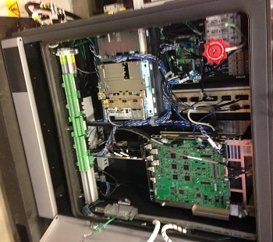
Hardware
Standard in all DX200 Controllers
Breakout card (YCF22)
CN219 on schematics
Machine I/O board (YSF22B-E)
Machine Safety board (YSF21-E)

Slide 4
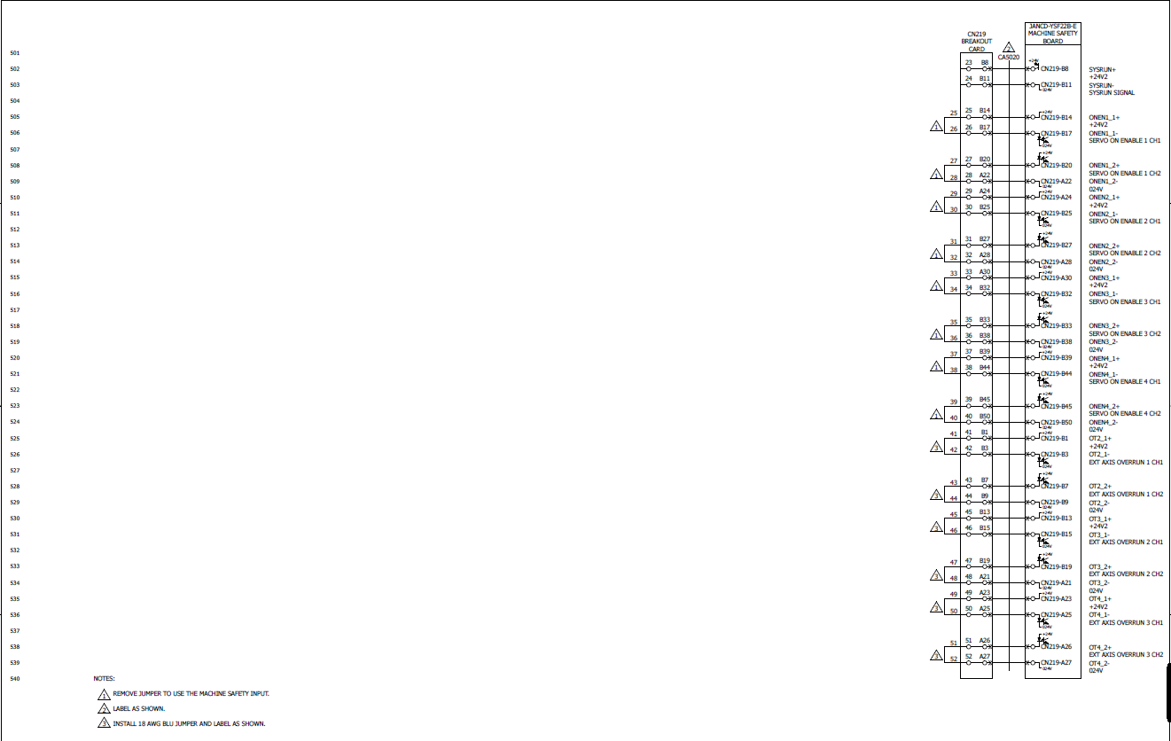
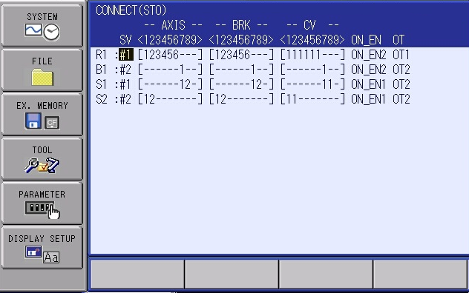
Hardware
Sheet 5 of schematics
Servo OnEnable 1-4
Ext Axis Overrun 1-3
STO
(Independent Control)
Non standard setup

Slide 5
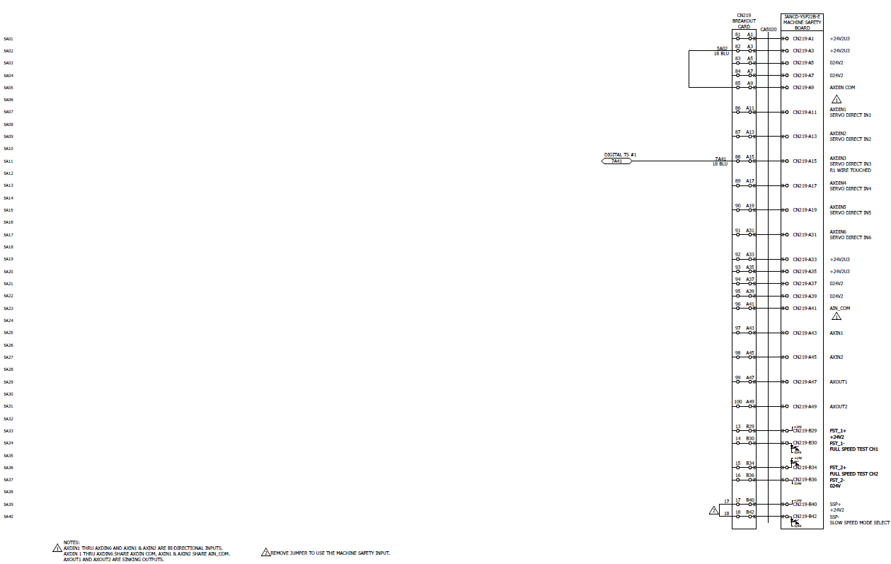
Hardware
Sheet 5A of schematics
Servo Direct Inputs 1-6 (Rapid inputs)
AXIN 1 &2
AXOUT 1 &2
Full Speed Test
Slow Speed Mode

Slide 6
Hardware
Sheet 5B of schematics
External Enable
(Deadman)
Machine Safety Inputs (GSIN1 &2)
Machine Safety Outputs (GSOUT1 &2)
Machine Safety EDM (GSEDM1 &2)
Safety I/O
2 Inputs (Dual Channel)
Sink/Source
2 Outputs (Dual Channel)
Sink/Source
STO Function
Note: EDM Jumpers not installed on Standard

Slide 7
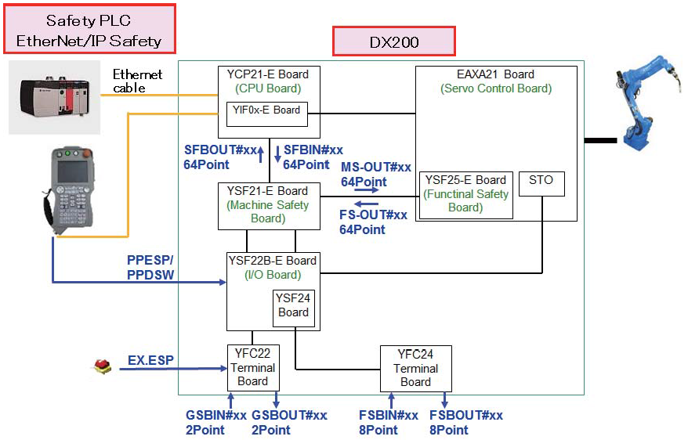
Expansion function
Adds communication between machine safety and functional safety (FSU)

Slide 8
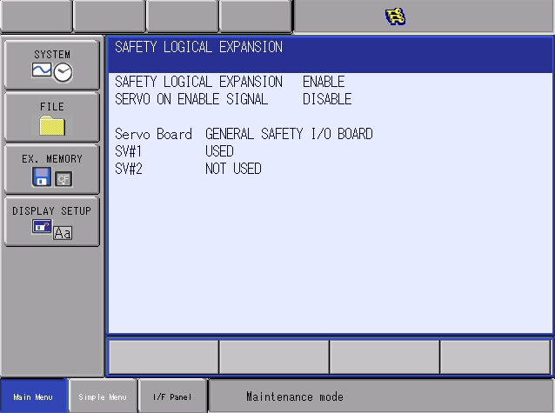
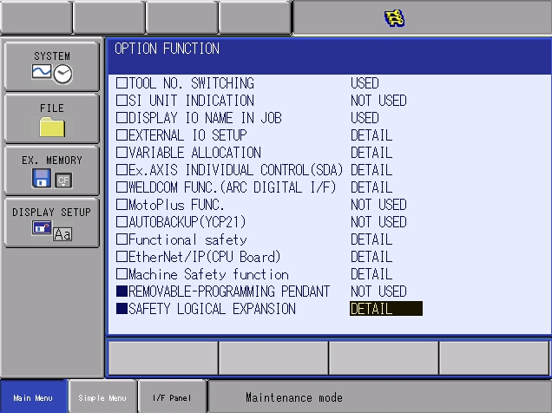
Expansion function
Option Function for software 1.8 and greater
Must be in yaskawa mode to enable
Use safety boards that are in safety logic circuit.

Slide 9
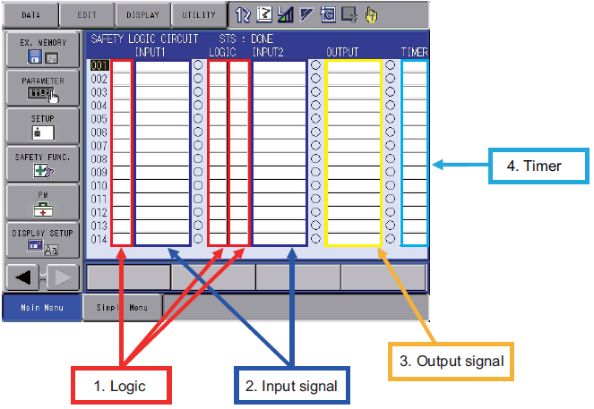
Safety Logic Circuit
128 Lines of Logic
4 ms scan time
2 input signals 1 output signal per line – basic.
Backup File YSFLOGIC.DAT

Slide 10
1. Logic

Slide 11
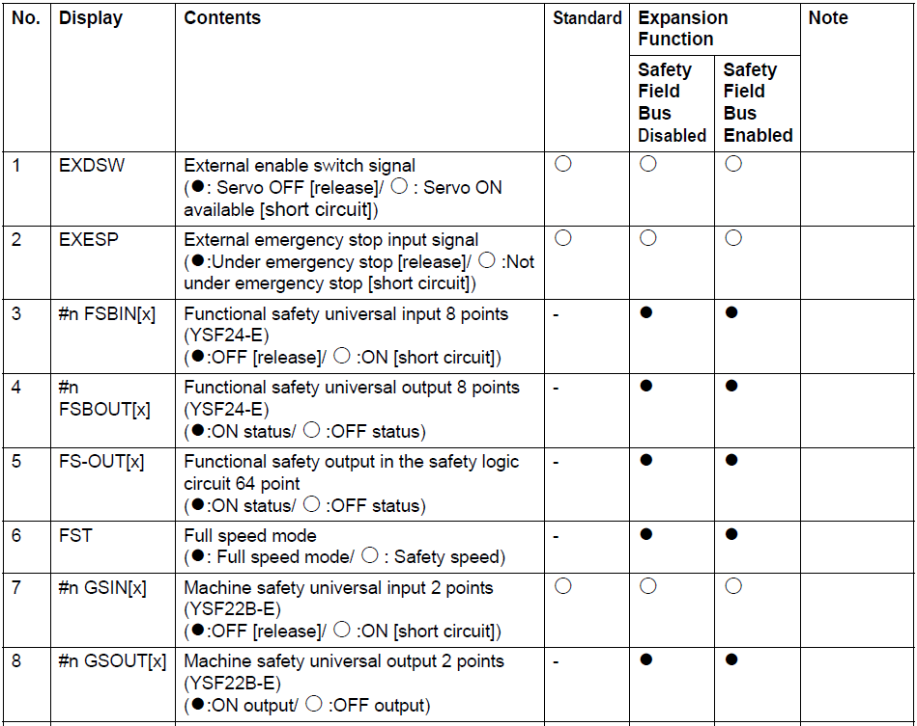
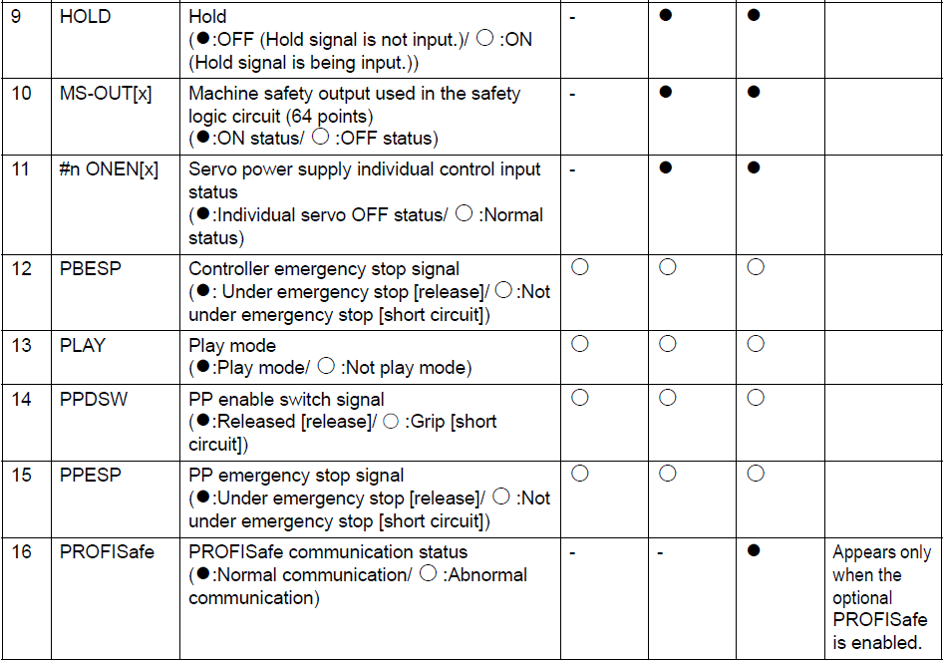
2. Input Signals

Slide 12
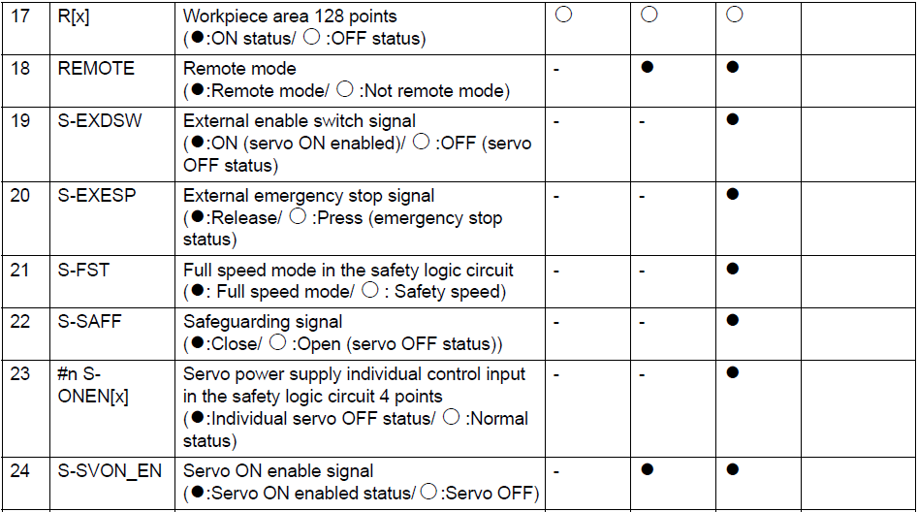
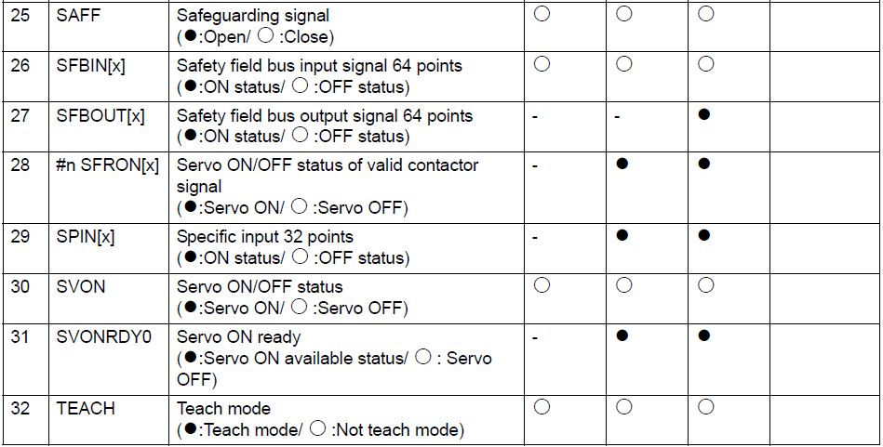
2. Input Signals

Slide 13
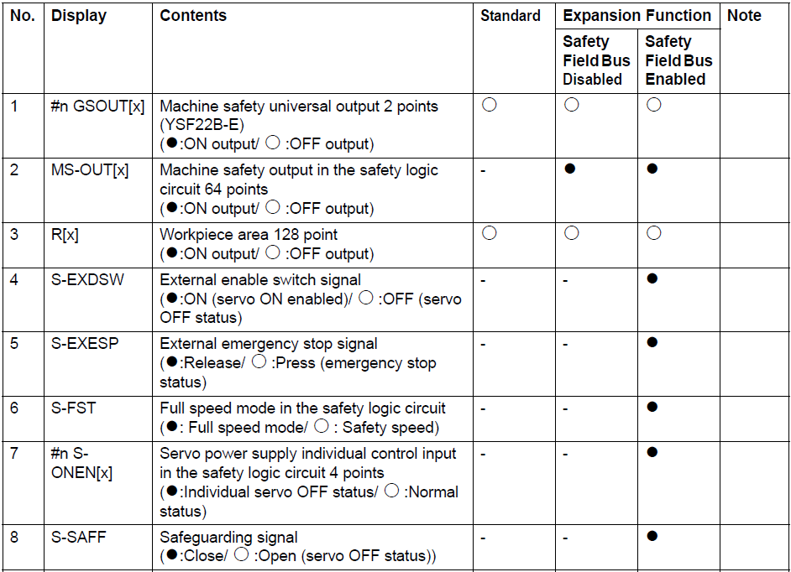
3. Output Signals
#n FSB OUT Functional Safety Output 8 points

Slide 14
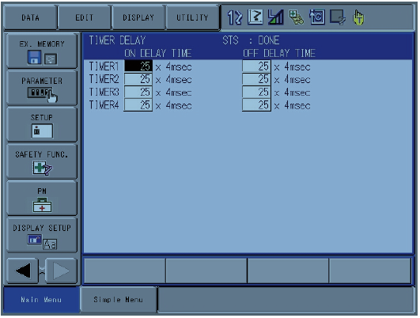
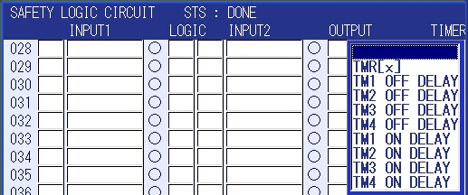
4. Timer
Select off or on delay

Slide 15
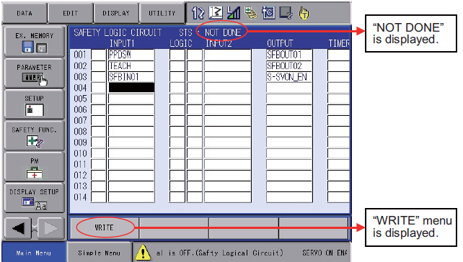
Expansion function
Program must be written and confirmed.
After modification
After loading YSFLOGIC.DAT file from network
Loading CMOS

Slide 16
I/O Configuration
SLC signal display setup
Assignment of functional safety output signals
Assignment of ext output signals

Slide 17
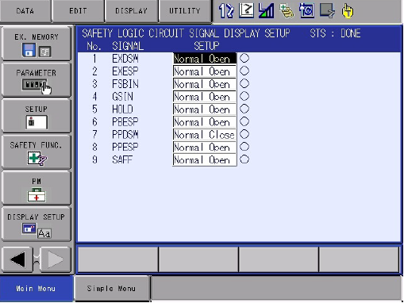
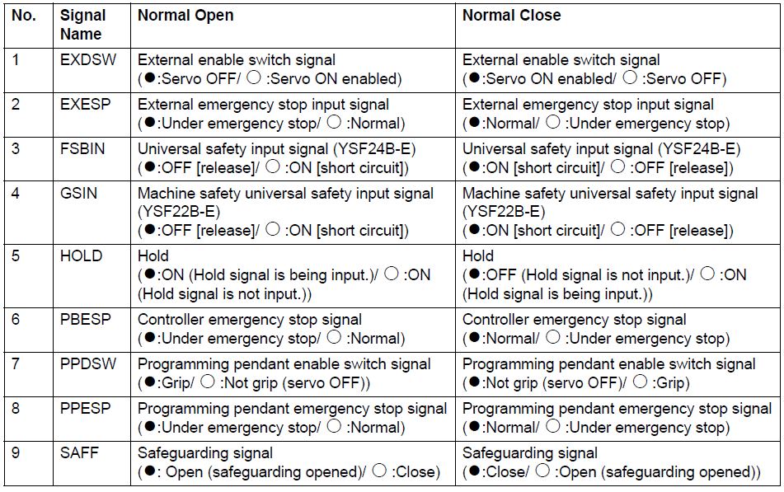
SLC signal display setup
Standards set all signals but PPDSM to Normal Close
Write and Confirm to change setting on pendant
Setup is located YSFLOGIC.DAT file of robot.

Slide 18
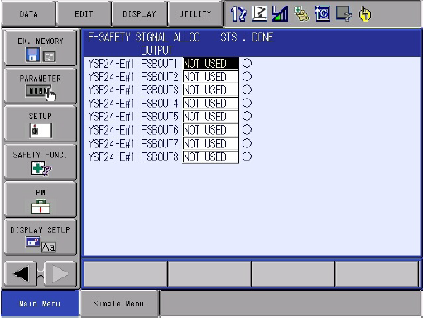
F Safety Signal Allocation - Output Signals
The FSU hardware outputs (FSBOUT) can be assigned for use in machine safety logic.
Assignment of a FSBOUT set to YSF21-E, the output can only be used by machine safety logic
Assignment of a FSBOUT set to YSF25-E #n output can be used by FSU functions only
Setting of not used can’t be used by machine safety logic or FSU functions.
Use page key to configure multiple FSU configurations
Use of older standard may need to add this configuration.

Slide 19
SLC EXT signal allocation
The FSU logical outputs (FSOUT)can be assigned for use in multiple FSU units.
Assignment of a FSOUT set to YSF25-E #n, the output can only be used by the n FSU functions.
For example, YSF25-E #2 is available for use for FSU in R2 functions
Setting of not used can’t be used by any robot’s FSU.

Slide 20
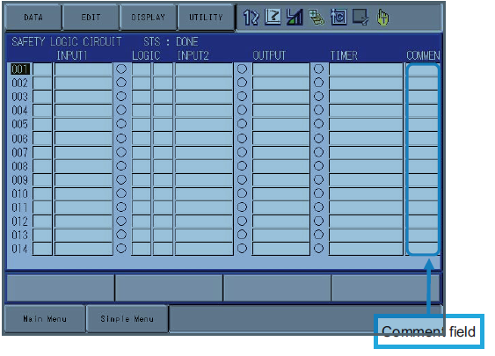
Safety Logic Circuit Comments
32 Characters
Press main menu if you can’t see comments. Cursor to right side.
Font size can be changed under the display settings icon
Must write and confirm comments

Slide 21
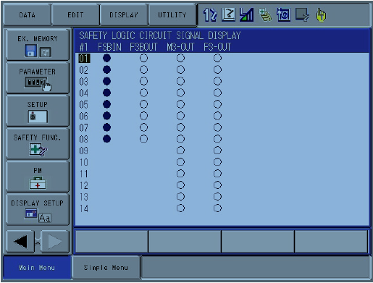
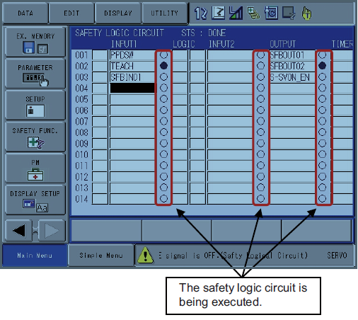
Troubleshooting
Check I/O Status
Check Logic Status
Input signals are filled when off, and outlined when on
Logic filled when on, outlined when off

Slide 22
CIO Signals
Safety Fieldbus (Inputs 1-64,Outputs 1-64)
FSB (Boards 1- 8, Inputs 1-8, Output 1-8)
Safety Logic Circuit (MS Out 1-64)
Funtional Safety logic circuit (FS Out 1-64)
How can these CIO signals effect the electrical design?

Slide 23
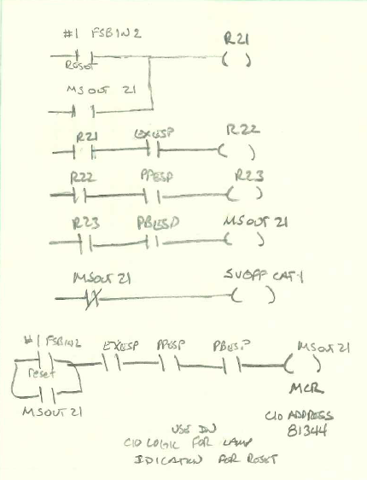
Example
Add manual E-Stop reset
Hardware
Add Dual channel reset to functional safety input 2.
Add E-Stop reset lamp to universal output 24.
Draw logic on paper in robot format
MSOUT 21 used instead of R24 for CIO address to write logic for reset lamp.
MSOUT 21 is CIO address 81344

Slide 24
Example
Set SLC display setup for FSBIN to normally closed.
How could E-Stop OK Output be programmed to #1 FSB Output 2?

Slide 25
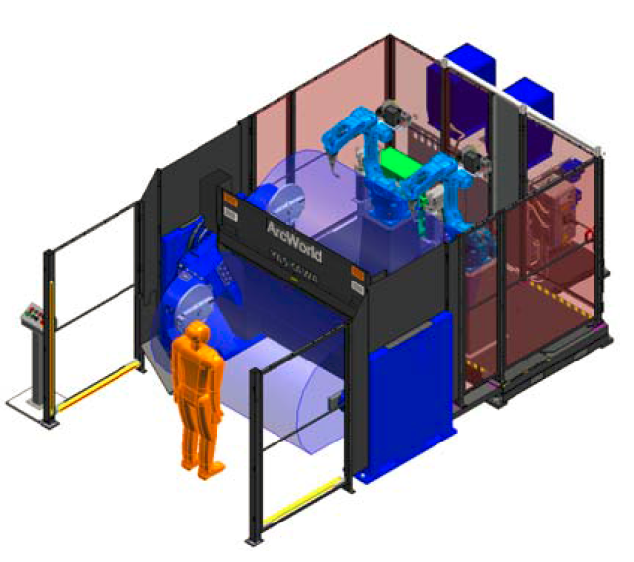
DX200 ArcWorld IV 6X00 with integrated safety logic
Information located under Standard World Jobs
Removed Pilz Multi safety PLC
Theory of operation document explains safety operation, FSU files setup, and safety logic
Side A/B switches are no longer used on positioner
May be physically on positioner
FSU Axis range limit function used
Integrated safety logic uses status from FSU to solve logic and perform safety function.
Reduces wiring and external hardware
FSU standard only on R1
SYS Critical FSU Funct Disabled alarm
Safety checkout of system uses QC check sheet

Slide 26
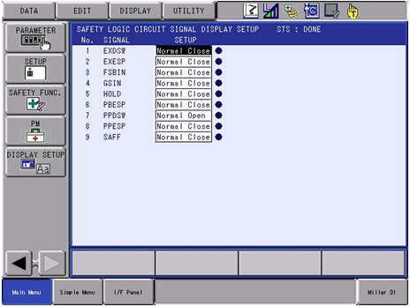
DX200 ArcWorld IV 6X00 with integrated safety logic
SLC Signal Display Setup

Slide 27
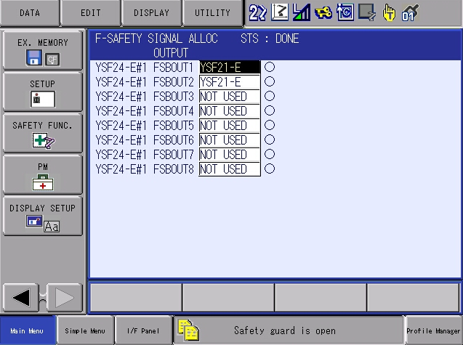
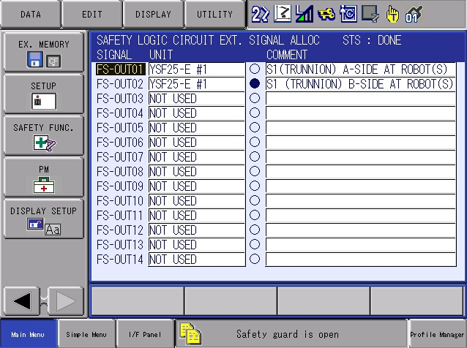
DX200 ArcWorld IV 6X00 with integrated safety logic
F-Safety Signal Allocation
SLC EXT Signal Allocation

Slide 28
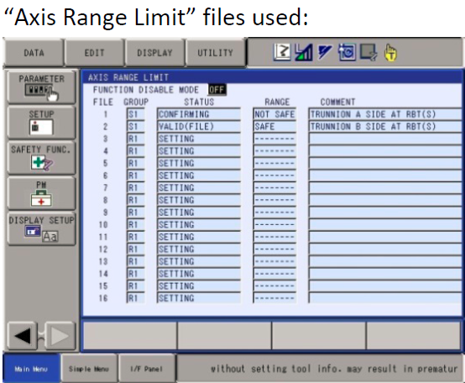
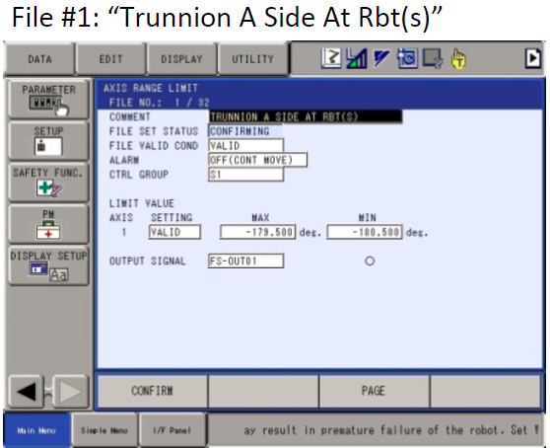
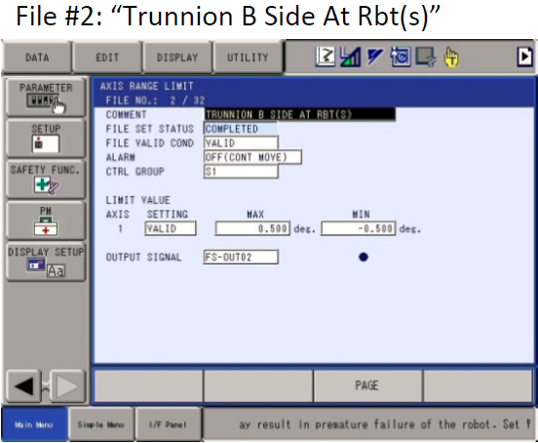
DX200 ArcWorld IV 6X00 with integrated safety logic
Inputs for integrated safety logic
#1 FSU In1 – Light Curtain (hardwired)
FSU files- Positioner At side A/B
Why is light curtain relay used?

Slide 29
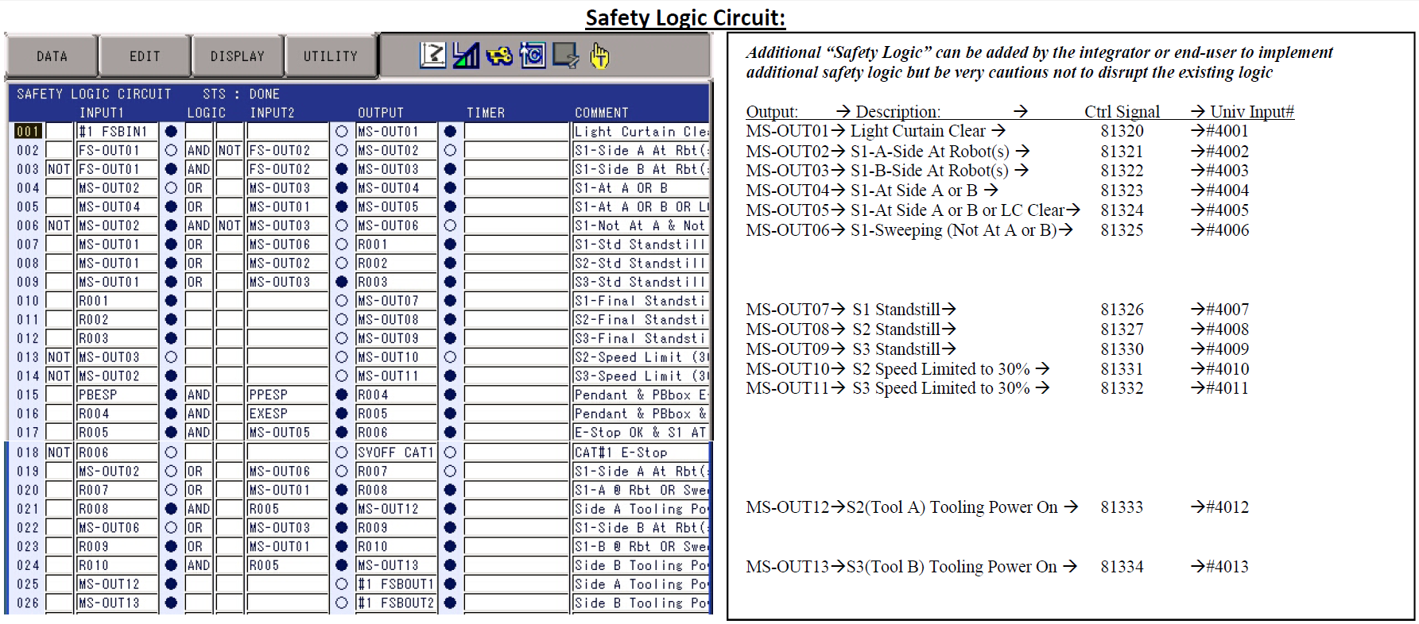
DX200 ArcWorld IV 6X00 with integrated safety logic

Slide 30
DX200 ArcWorld IV 6X00 with integrated safety logic
Break down safety logic to specfic safety functions
S1 Standstill – Stops motion of positoner trunion
S2 Standstill – Stops motion of Side A tool
S3 Standstill – Stops motion of side B Tool
S2 Speed limit – Limits Side A speed to 30%
Safety distance requirement
S3 Speed limit – Limits Side B speed to 30%
Safety disatnce requirement
Servo Off Cat1 – Stops motion of robot(s) and postioner Trunion and tooling axis

Slide 31
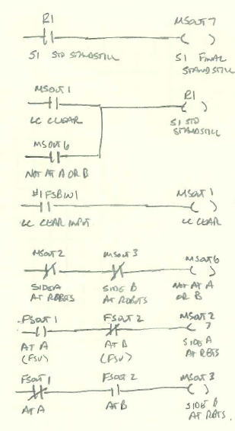
DX200 ArcWorld IV 6X00 with integrated safety logic
S1 Standstill Positioner Trunion – MSOut7
Stop positioner when the light curtain is broken only if at side A or B.
Reduces movement from using only switches
Standstill not used during sweep because of Cat0 Stop. Servo off Cat1 used during sweep
S1 Final Standstill allows for custom content to be added

Slide 32
DX200 ArcWorld IV 6X00 with integrated safety logic
S1 Standstill Positioner Trunion – MSOut7
Stop positioner when the light curtain is broken only if at side A or B.
Reduces movement from using only switches
Standstill not used during sweep because of Cat0 Stop. Servo off Cat1 used during sweep
S1 Final Standstill allows for custom content to be added

Slide 33
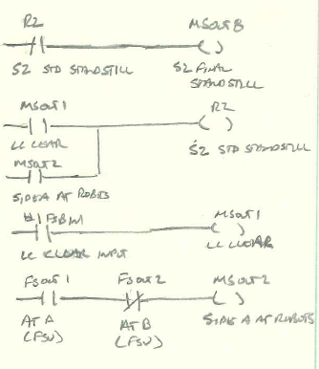
DX200 ArcWorld IV 6X00 with integrated safety logic
S2/S3 Standstill SideA/B Tool – MSOut7&8
Stop tooling axis when at operator and light curtain broken.
Eliminates need for tooling “in position” switches
Allows for programmable load position
S2/S3 Final Standstill allows for custom content to be added

Slide 34
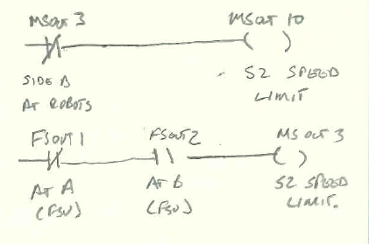
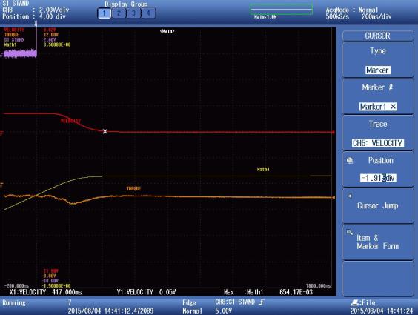
DX200 ArcWorld IV 6X00 with integrated safety logic
S2/S3 Speed Limit SideA/B Tool – MSOut10&11
Speed limit tooling axis
At operator side for joystick jog
Due to safety distance issue
30% speed was measured by standards via scope
S2/S3 Speed Limit allows for custom content to be added
All speed limit (standstill) FSU files are run when inputs are active.
Standstill and speed limit will both function at the same time, thus restricting any motion.

Slide 35
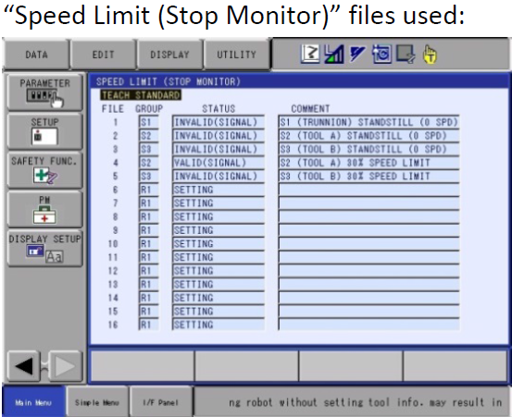
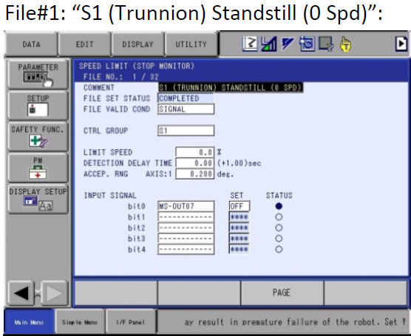
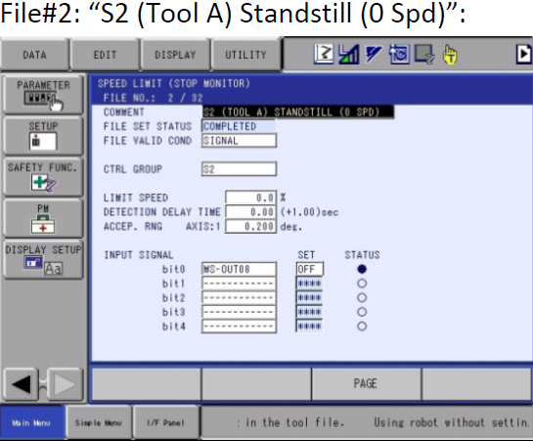
DX200 ArcWorld IV 6X00 with integrated safety logic
FSU Files – Speed Limit

Slide 36
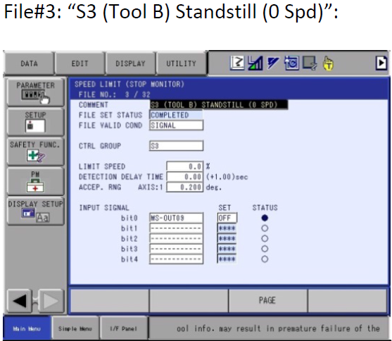
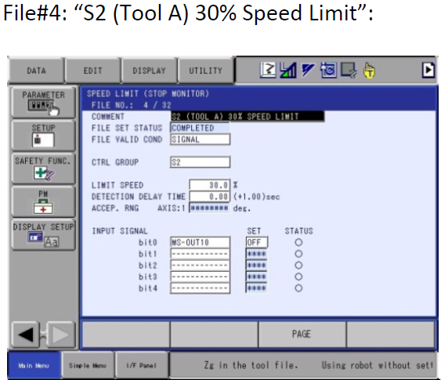
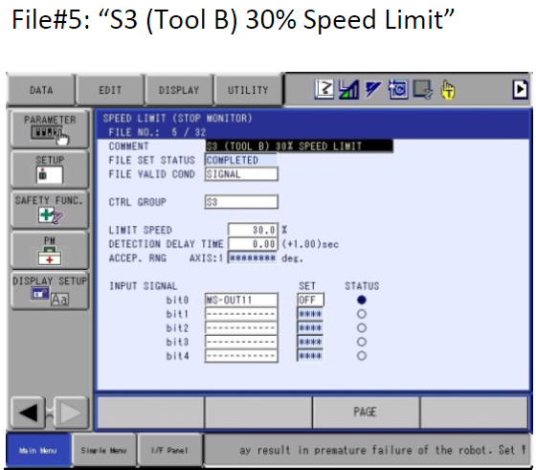
DX200 ArcWorld IV 6X00 with integrated safety logic
FSU Files – Speed Limit - Continued

Slide 37
DX200 ArcWorld IV 6X00 with integrated safety logic
Servo Off Cat1
Stop robot(s) and positioner
When light curtain is broken while positioner is sweeping
E-Stop & Gate circuits are still used in addition

Slide 38
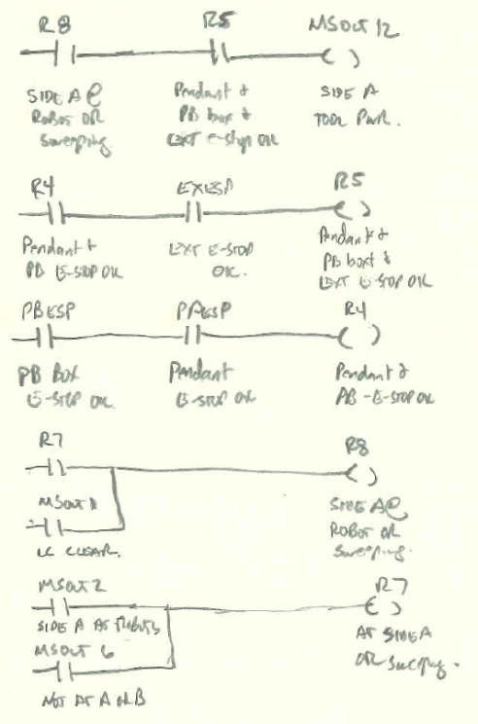
DX200 ArcWorld IV 6X00 with integrated safety logic
Side A/B Tooling power – MSOut11&12
Turns off when
Programming Pendant E-Stop Pressed
External E-Stop
PB E-Stop. Standard continues to use, even though no box is present.
Light curtain is invaded and tooling is at operator
Risk assessment required for tooling control while light curtain invaded.
Safety logic modifications required
#1 FSB Out1&2 allows for custom content to be added

Slide 39
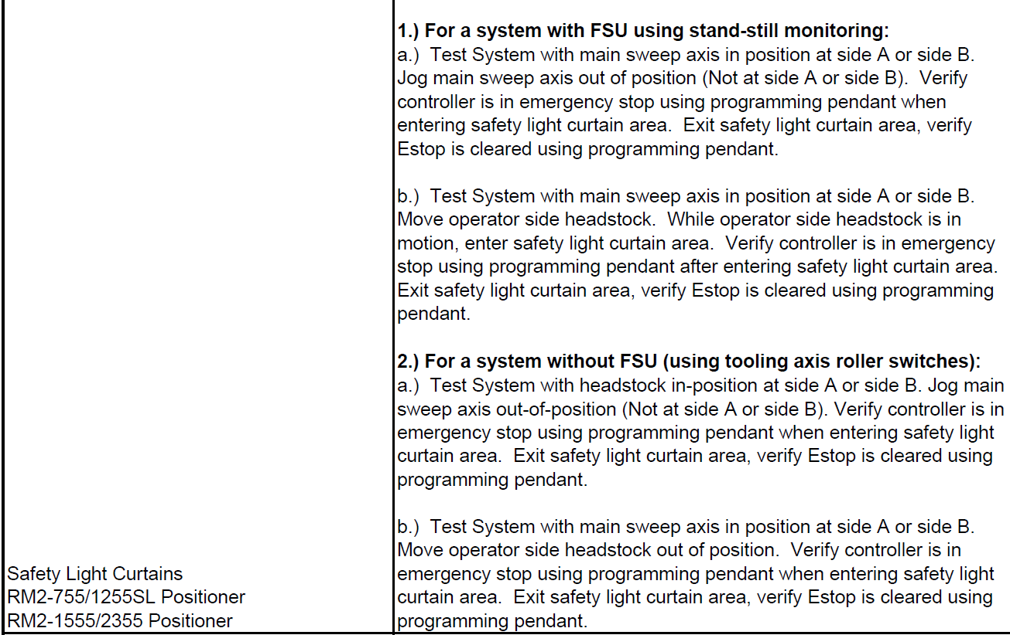
DX200 ArcWorld IV 6X00 with integrated safety logic
Standard is verified by MFGF-266 check sheet.
No change for safety PLC or integrated safety
Add additional documentation for checks required due to changes in system configuration/safety logic

Slide 40
Program steps
Review Standards located on the standard world jobs section of the inet. (AW6X00 & AW2X00)
Write logic on paper in robot format
Verify logic requirements for both E-Stop and safety. Only one servo off output. Use Cat1.
Develope test plan for safety logic

Slide 41
Program steps
Enable Expansion Function
Set I/O to Be used
Machine safety and expansion function.
Verify EDM status of machine safety
Sync vs non sync.
Functional safety
Set SLC signal display setup
Write/confirm
Assign F safety output signals
Write/confirm
Assign SLC Ext output signals
Write/confirm
Enter logic – On Pendent at this time
Enter a few lines at a time
Write/Confirm
I/O check
Safety logic validation per test plan
Backup files.

Slide 42
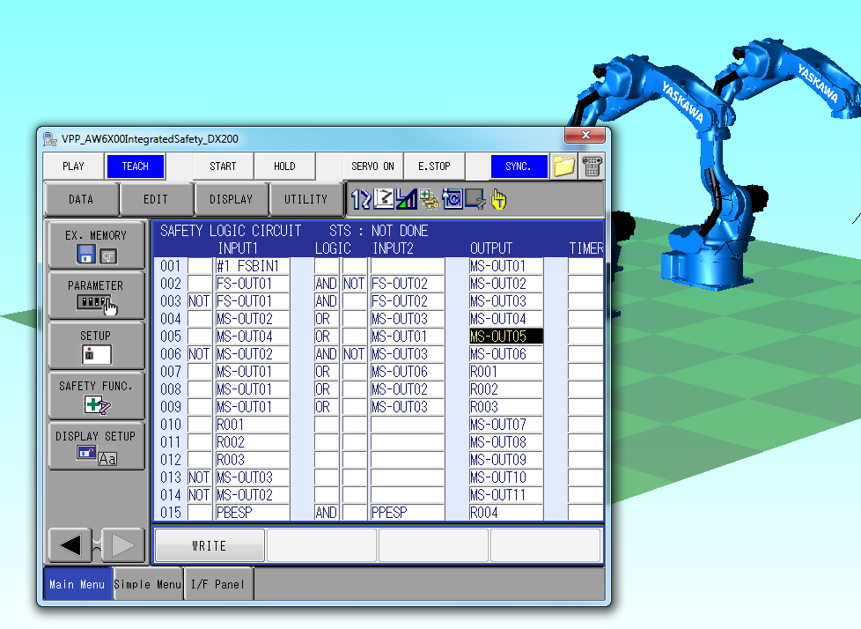
Offline Logic Programming
MotoSimEG-VRC Version 2015 Sp2
Supports inform software version 1.8
Software key required
Template file AW6X00integratedSaftey located on share point
Create YSFLogic.dat file to load into controllers
Decrease startup time
FAQ also located on share

Slide 43
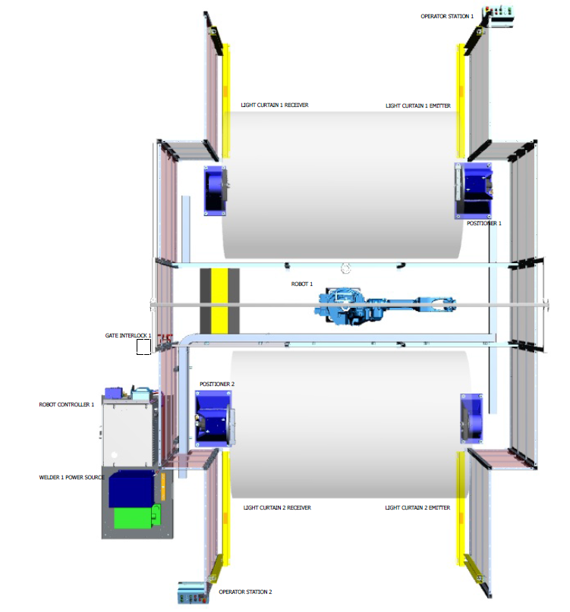
DX200 ArcWorld 2000 only integrated safety logic
New name for an old favorite (Fabworld)
Information located under Standard World Jobs
Theory of operation document explains safety operation, FSU files setup, and safety logic
Zone rings removed from robot(s)
FSU Axis range monitoring replacement
Positioner in position switches removed
Standstill speed limit replacement
Integrated safety logic uses status from FSU to solve logic and perform safety function.
Reduces wiring and external hardware
FSU standard on R1 (and R2 AW2200)
SYS Critical FSU Funct Disabled alarm
Safety checkout of system uses QC check sheet

Slide 44
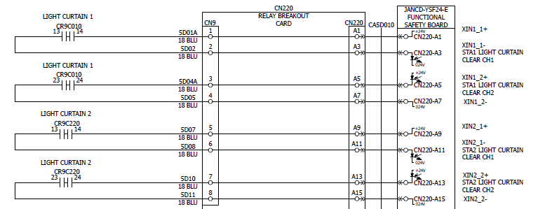
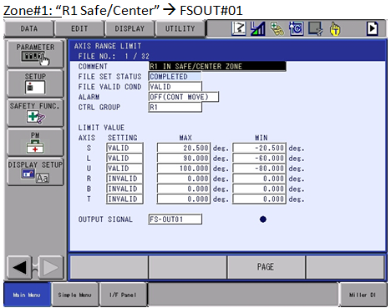
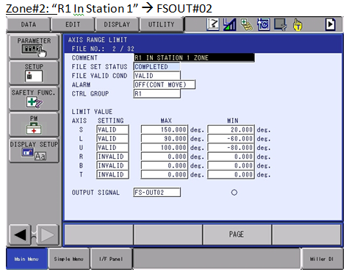
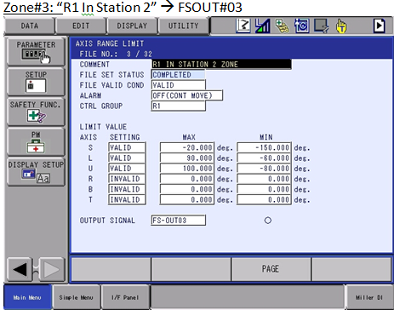
ArcWorld 2000 only integrated safety logic
Inputs for integrated safety logic
#1 FSU In1 – Light Curtain Sta1 (hardwired)
#1 FSU IN2 – Light Curtain Sta2 (hardwired)
FSU files- Robot 1 and 2 zones

Slide 45
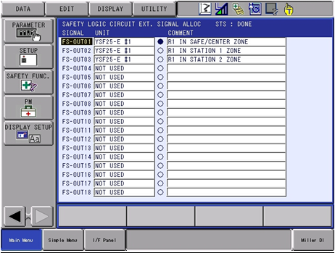
DX200 ArcWorld IV 2000 only integrated safety logic
SLC Signal Display Setup
SLC EXT Signal Allocation

Slide 46
DX200 ArcWorld IV 2000 only integrated safety logic

Slide 47
DX200 ArcWorld 2000 only integrated safety logic
Break down safety logic to specfic safety functions
S1 Standstill – Stops motion of Station1 positioner
S2 Standstill – Stops motion of Station2 positioner
Servo Off Cat1 – Stops motion of robot and postioners
FSU range limits

Slide 48
DX200 ArcWorld 2000 only integrated safety logic
Homework
Review positioner Standstill logic
Review servo off logic
Review range monitoring zone(s), explain zone(s) limits

Slide 49
Objectives
Review Machine Safety Hardware
Expansion function
Response Time
Safety Logic Circuit
I/O configuration
Offline Programming
Standards applications

